Slide 1
Delete Slide
!
There are five common variations for operator training
The variations are for How XL is Installed, Start Shift, Start Part, Start Break, and End Shift
Each variation is called out with a slide that looks like this one
Keep the slide for the variation you use and delete the other slide

Slide 2
Operator’s Guide to XL
XL Champion Name Goes Here
Your Company Name Goes Here

Slide 3
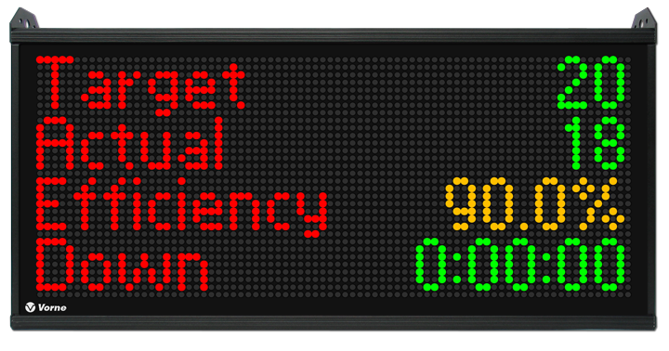
What is XL?
An operator’s perspective
XL is a plant floor scoreboard with integrated metrics and reporting
XL captures key metrics and displays information for you in real-time
Operators use barcode scanners to log down reasons and to change parts
Our goal is to “win the shift” by meeting or beating the Target metric

Slide 4
Who Uses XL?
Operators, supervisors, managers
We all need accurate information to help us make good decisions
On the plant floor XL gives you clear visibility of goals and how we are doing
Supervisors can see areas that need extra attention in real-time
Managers can see trends over time and plan for the future

Slide 5
Delete Slide
!
Delete this slide AND one of the two next slides
Have you installed XL on a single-step process or a multiple-step process?
Delete the slide that does not apply

Slide 6
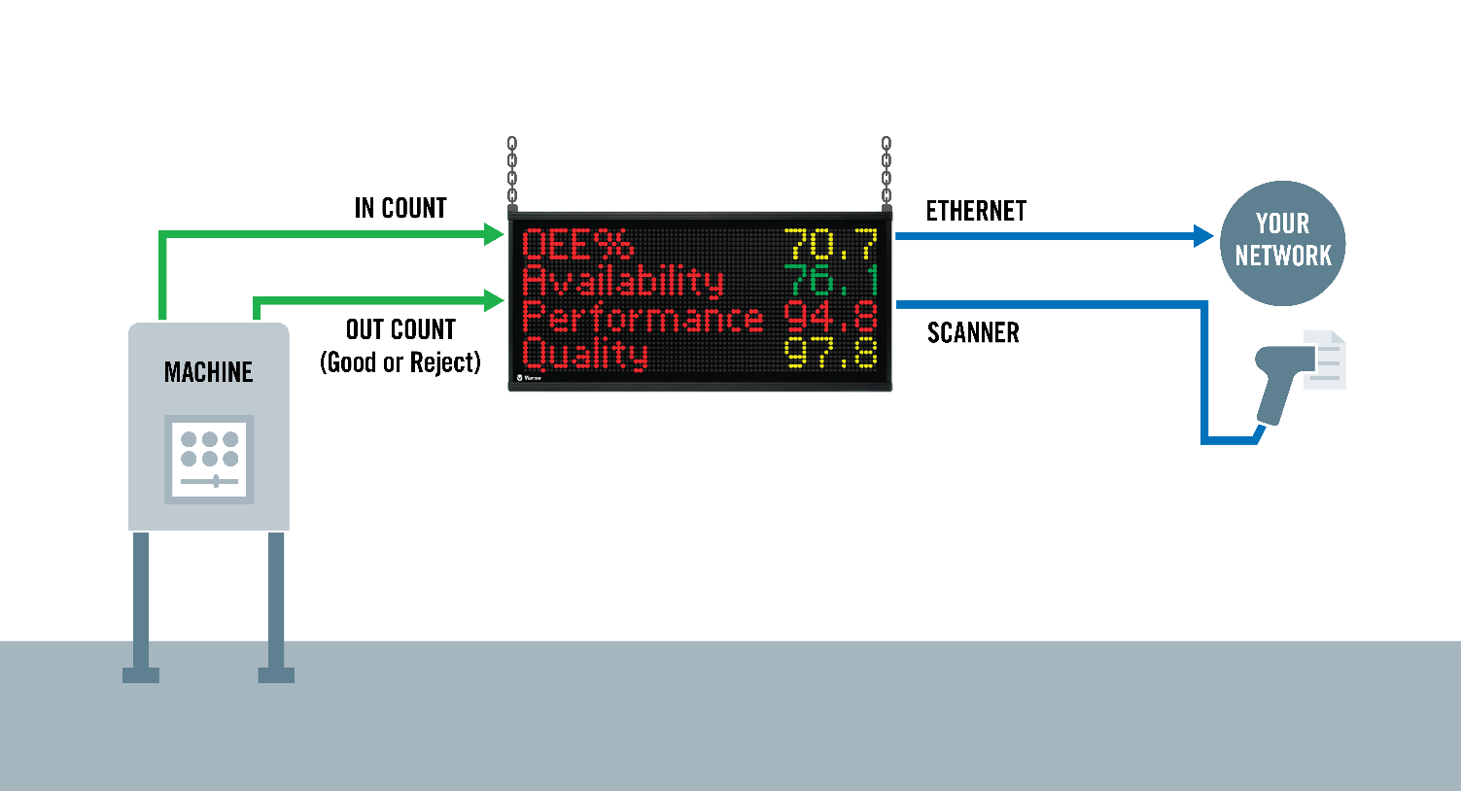
How XL is Installed
XL is easy to install and use
Scoreboard shows us what is happening on the plant floor
Sensors automatically monitor production for you
Barcode scanner is the primary way you provide information to XL
Network connection enables us to see production data from our browser

Slide 7
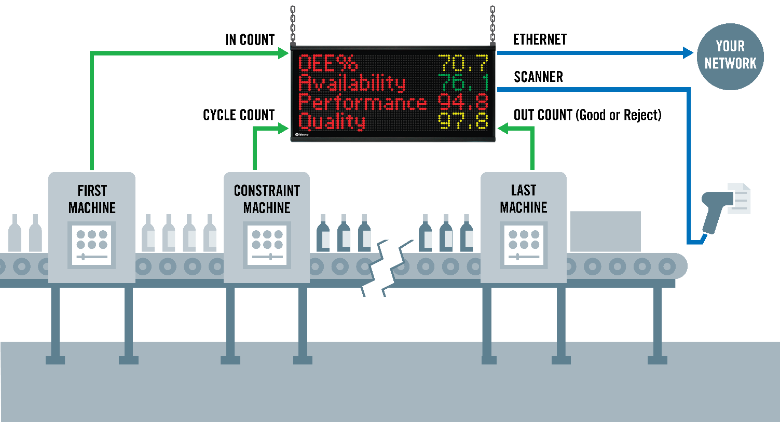
How XL is Installed
XL is easy to install and use
Scoreboard shows us what is happening on the plant floor
Sensors automatically monitor production for you
Barcode scanner is the primary way you provide information to XL
Network connection enables us to see production data from our browser

Slide 8
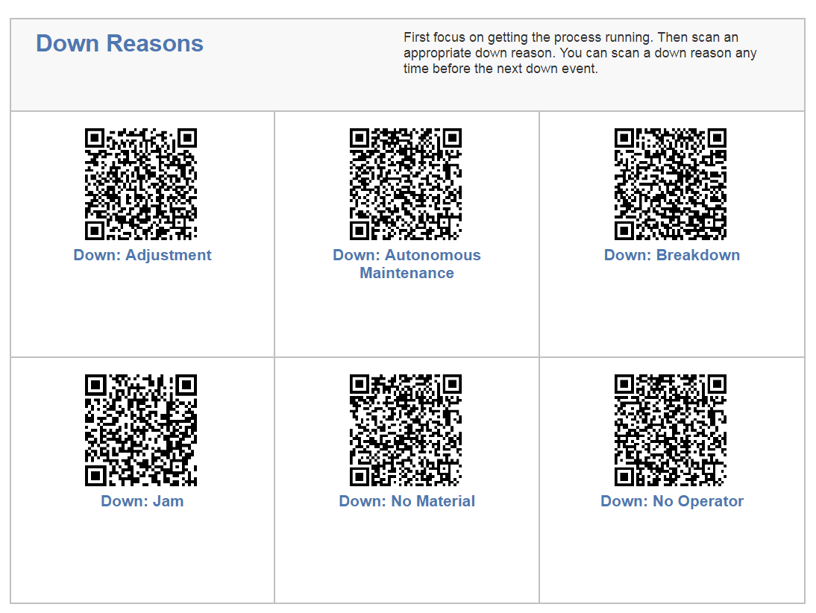
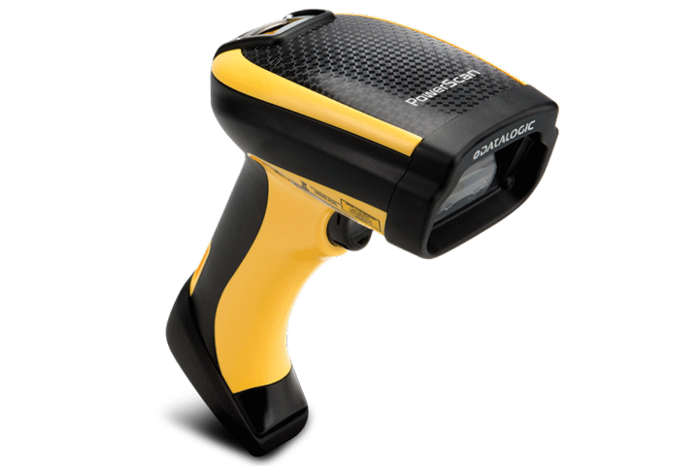
Barcode Scanning
The barcode scanner typically captures three things
Down Reasons (helps us to identify improvements)
Part Changes (applies correct settings for each part)
Planned Stops (planned stops that are not reflected in time schedule)

Slide 9
Delete Slide
!
Delete this slide AND one of the two next slides
Do you start the shift automatically via Time Schedule or manually by Barcode?
Delete the slide that does not apply

Slide 10
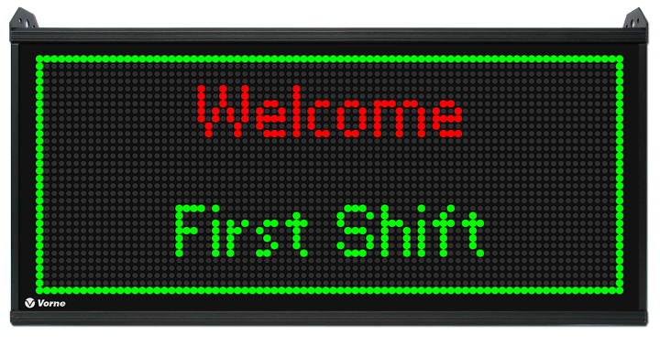
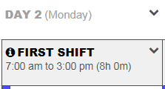
Start Shift Time Schedule
Shift Starts
Welcome !
KPI Screen
Our shift starts automatically
Shift Starts (XL automatically starts the shift)
Scoreboard (shows Shift ID, then KPIs)
XL counts time outside of the shift as Not Scheduled (so it does not affect OEE)

Slide 11
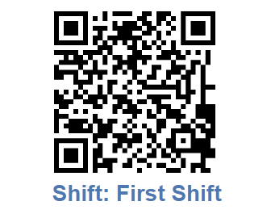
Start Shift Scan Barcode
Scan Shift
Welcome !
KPI Screen
Our shift starts when we scan the “Shift” barcode
Scan Shift (scan the appropriate Shift ID barcode)
Scoreboard (shows Shift ID, then KPIs)
XL counts time outside of the shift as Not Scheduled (so it does not affect OEE)

Slide 12
Delete Slide
!
Delete this slide AND one or both of the next 2 slides
Are you scanning Teams and/or Teams and Shifts?
Delete the slide that does not apply

Slide 13
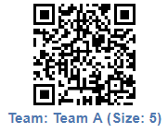
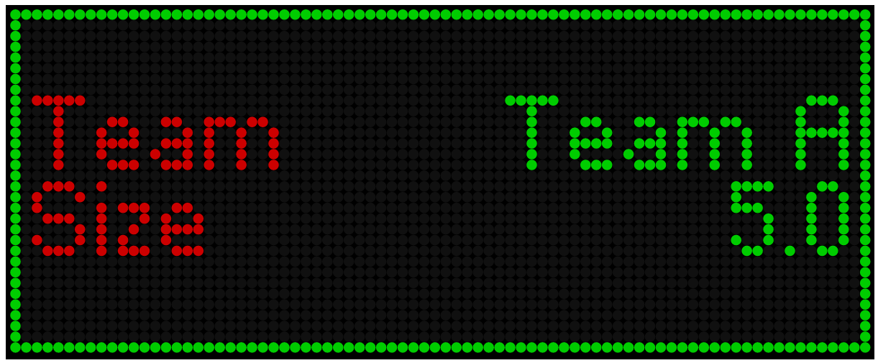
Start New Team
Scan Team
Welcome !
KPI Screen
We’re tracking Teams within Shifts.
Start Team (scan the appropriate Team ID barcode)
Scoreboard (shows Team ID, and Team Size then KPIs)

Slide 14
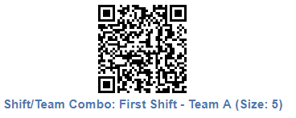
Start New Shift and Team
Scan Shift and Team
Welcome !
KPI Screen
We’re tracking Teams within Shifts.
Start Team (scan the appropriate Team ID barcode)
Scoreboard (shows Team ID, and Team Size then KPIs)

Slide 15
Delete Slide
!
Delete this slide AND one of the two next slides:
Do you start parts With Changeover or Without Changeover?
Delete the slide that does not apply

Slide 16
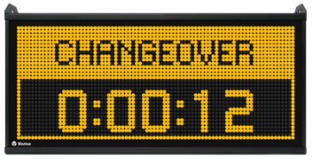
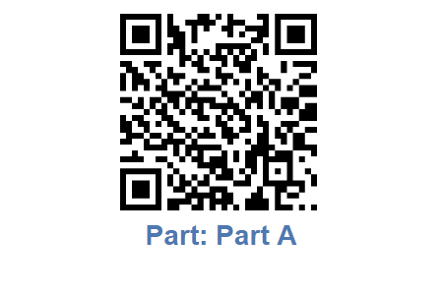
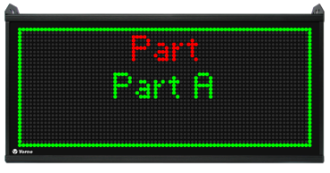
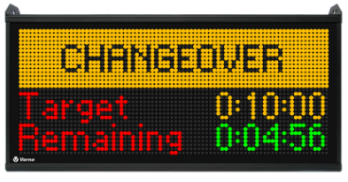
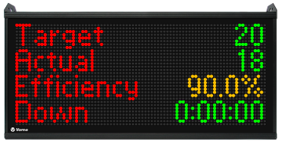
Start Part With Changeover
or
End by target
End by scan
End by running
Scan Part
Part ID
Changeover
End Changeover
KPI Screen
For each part we run
Scan Part (scan the appropriate Part ID barcode)
Scoreboard (shows Part ID for five seconds, then Changeover)
End Changeover (by target time, by starting production, by scanning)
Scoreboard (shows KPIs)
Select One

Slide 17
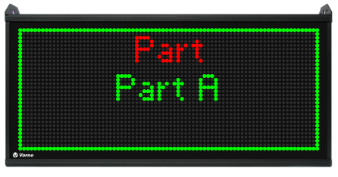
Start Part Without Changeover
Scan Part
Part ID
KPI Screen
For each part we run
Scan Part (scan the appropriate Part ID barcode)
Scoreboard (shows Part ID for five seconds, then KPIs)

Slide 18
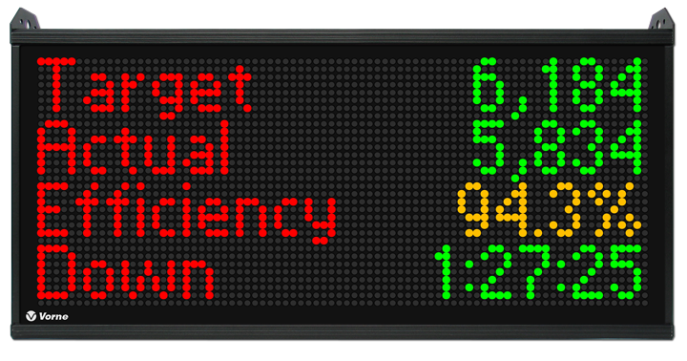
Run Scoreboard
When we are running
The scoreboard shows KPIs (key performance indicators)
Target shows your real-time production goal – aim to beat this number!
If Efficiency is 100% or greater, we are beating our Target and winning our shift
Efficiency changes color depending on how well we are running (red, yellow, green)

Slide 19
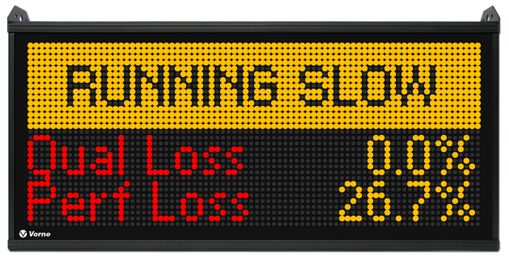
Running Slow Scoreboard
When we are running slow
When XL detects many slow cycles or small stops in the last minute or so, it displays Running Slow on the scoreboard
It also displays OEE Quality Loss and OEE Performance Loss for the same period

Slide 20
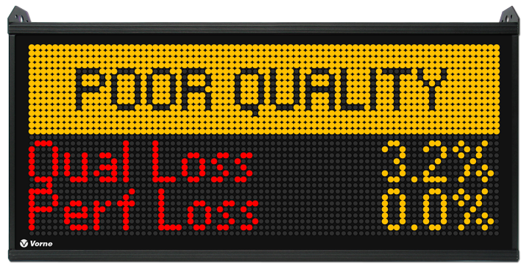
Running Poor Quality Scoreboard
When we are making reject pieces
When XL detects reject pieces in the last minute or so, it displays Poor Quality on the scoreboard
It also displays OEE Quality Loss and OEE Performance Loss for the same period

Slide 21
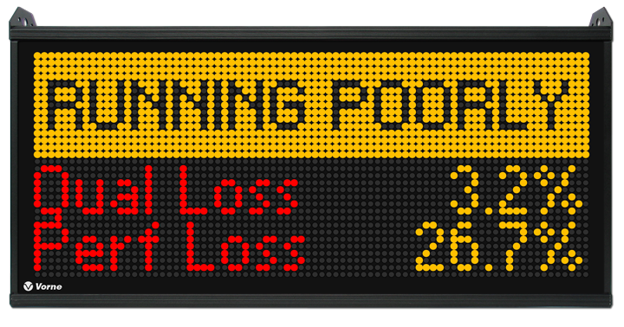
Running Poorly Scoreboard
When we are running slow AND making reject pieces
When XL detects many slow cycles or small stops and reject parts in the last minute or so, it displays Running Poorly on the scoreboard
It also displays OEE Quality Loss and OEE Performance Loss for the same period

Slide 22
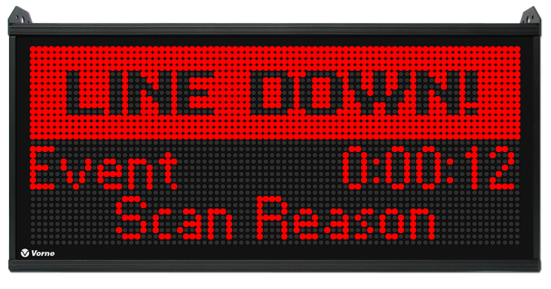
Down Automatic Detection
XL automatically detects down events
We don’t need to manually record down time – XL records down time automatically
We just scan a reason when XL displays Line Down
If we forget to scan a reason, we can scan after restarting the process
Small stops are not down events and no reasons need to be scanned

Slide 23
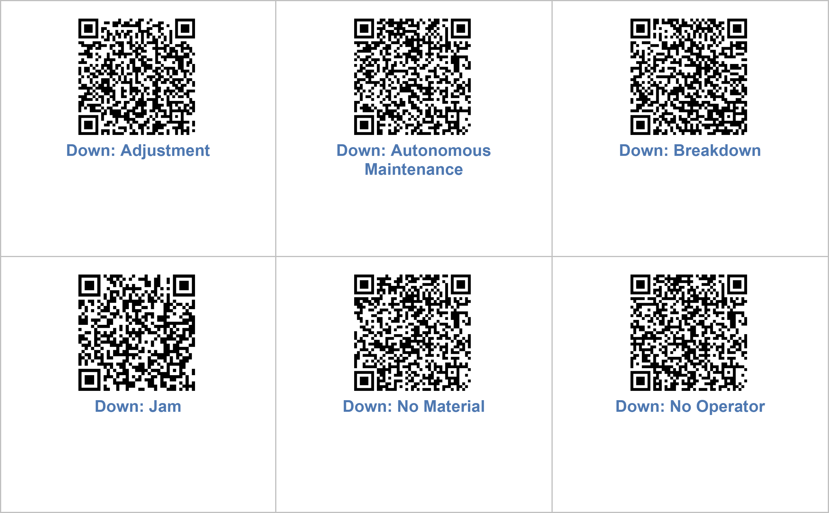
Down Reason Exercise
Let’s review our down reasons
When should we scan each of these reasons?
Are any of these reasons confusing?
Are we missing any reasons?
Are any reasons not needed?

Slide 24
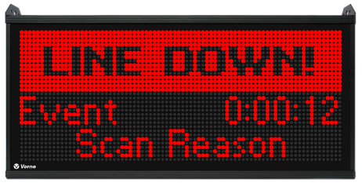
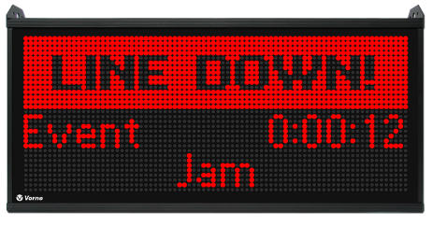
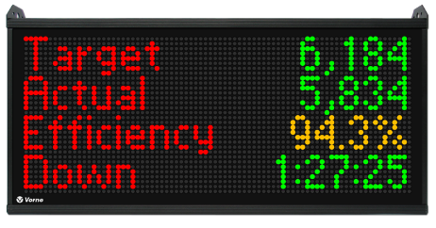
Down Reason Scan Barcode
Process Down
Scan Reason
Reason Displayed
KPI Screen
For each down event
First focus on getting the process running
Scan the appropriate reason as soon as you can
You can scan the reason any time before the next down event
If you make a mistake simply scan the correct reason before the next down event
If you forget to scan, XL displays Scan Reason at the bottom of the Run Screen

Slide 25
Delete Slide
!
Delete this slide AND one of the two next slides
Do you start breaks automatically via Time Schedule or manually by Barcode?
Delete the slide that does not apply

Slide 26
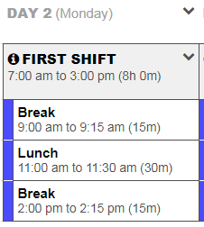
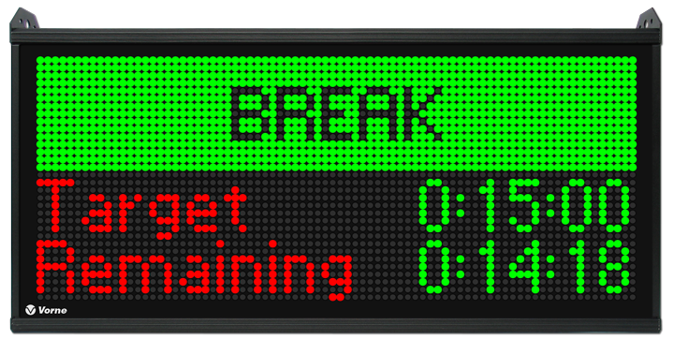
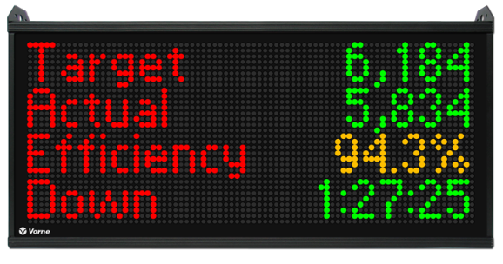
Start Break Time Schedule
Break Starts
Remaining Break Time
Break Over
For each break
Break Starts (XL automatically starts the break)
Scoreboard (shows remaining break time, then KPIs)

Slide 27
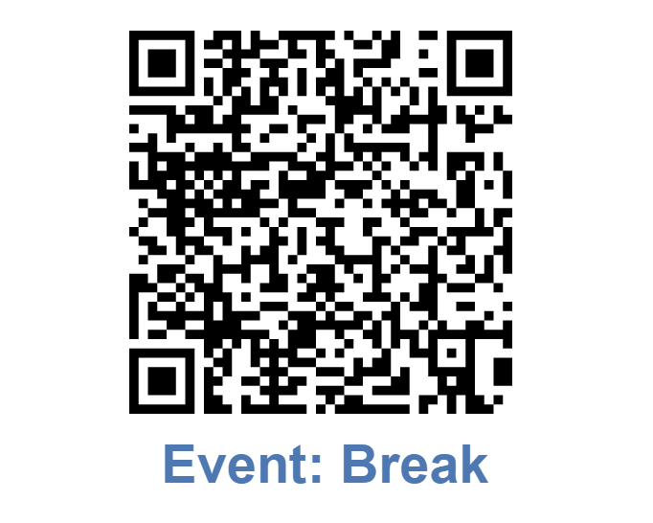
Start Break Scan Barcode
Scan Break
Remaining Break Time
Break Over
For each break
Scan Break (scan the appropriate break barcode to start the break)
Scoreboard (shows remaining break time, then KPIs)

Slide 28
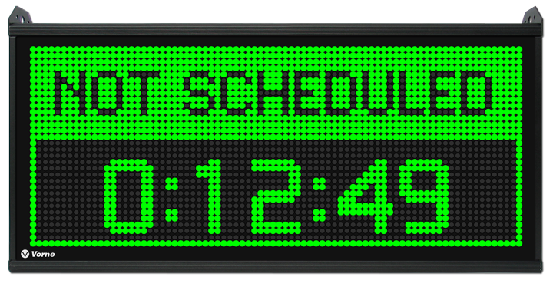
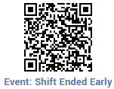
No Production Scan Barcode
Scan Shift Ended Early
No Production Timer
If there is no more work scheduled for the shift
Scan Shift Ended Early (scan barcode so idle time is not counted against OEE)
Scoreboard (shows reason and accumulated time)

Slide 29
Delete Slide
!
Delete this slide AND one of the two next slides:
Do you end shifts automatically via Time Schedule or manually by Barcode?
Delete the slide that does not apply

Slide 30
End Shift Time Schedule
Shift Ends
Not Scheduled Timer
Our shifts end automatically
Shift Ends (XL automatically ends the shift)
Scoreboard (shows Not Scheduled time)

Slide 31
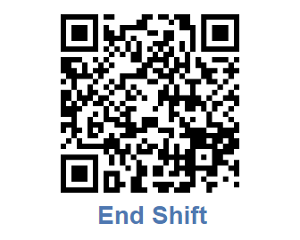
End Shift Scan Barcode
Scan End Shift
Not Scheduled Timer
Our shifts end manually by scanning a barcode:
Scan End Shift (scan barcode to end the shift)
Scoreboard (shows Not Scheduled time)

Slide 32
Frequently Asked Questions
What if I don’t scan a down reason?
You can scan a down reason any time before the next down event
If you don’t scan anything the event will be assigned a reason of Missing Reason
What if I forget to end my shift?
Use the time schedule when possible to start and end shifts
Otherwise, it is very important to scan End Shift
If you forget, XL will capture the time as down time
Can we change the KPI’s on the run screen?
Yes, your XL Champion can change the KPIs on the run screen

