Slide 1

Introducing XL
Installs in hours.
Configures in minutes.
Impacts immediately.
Introducing XL 2.18
www.vorne.com • 1.630.875.3600 • © 2021-2024 Vorne Industries, Inc. • Itasca, IL

Slide 2

What is XL?
Easy
Slide 8
Powerful
Slide 12
Cost-Effective
Slide 29
Succeed with Vorne
Slide 34
Introducing XL What is XL?
2
www.vorne.com • 1.630.875.3600 • © 2021-2024 Vorne

Slide 3
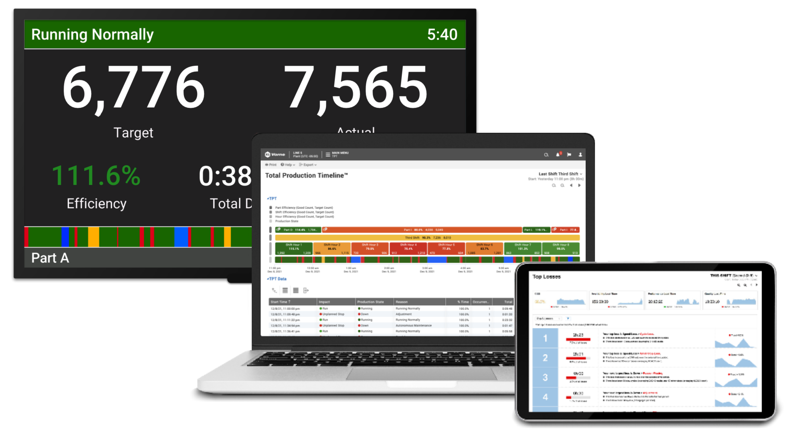
What is XL?
An IoT device with fully-integrated production monitoring and reporting.
One ”bolt-on” device that
includes a scoreboard, I/O, historian, and reporting
Simple to install, easy to integrate
Centralized reporting behind your firewall with no need for servers
A single source of accurate and precise information on losses
Eliminates manual data collection
A complete solution at a fixed and transparent cost
Introducing XL What is XL?
3
www.vorne.com • 1.630.875.3600 • © 2021-2024 Vorne

Slide 4
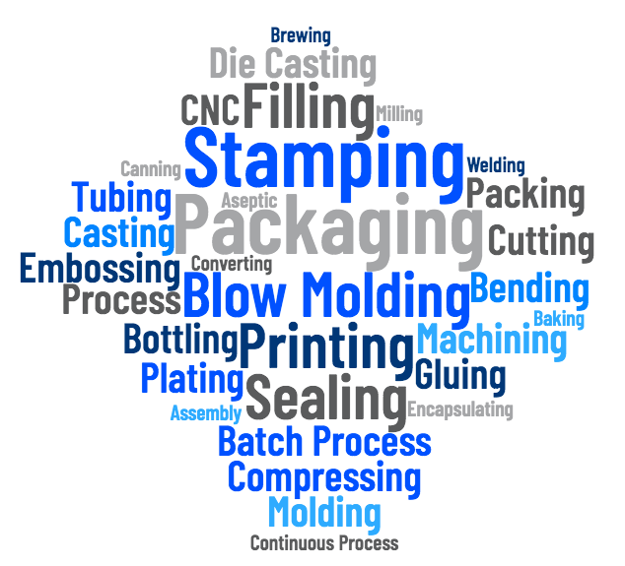
Why XL?
Installed in 35,000+ applications across virtually all industries.
Easily drops into any type of manufacturing process
Monitor all your processes in one browser-based application
Over 100 actionable metrics
and dimensions
Scalable – start with one work center and expand at your pace
Unlimited users with no license, maintenance, or other recurring fees
Fast and easy – avoids costly and complex projects
Introducing XL What is XL?
4
www.vorne.com • 1.630.875.3600 • © 2021-2024 Vorne

Slide 5
Case Study
Downtime Slashed by 94%
“The XL displays definitely generate a competitive interest on the plant floor.
Until we put the display up, it was not uncommon to see 160 minutes of shift downtime.
Now that the operators can see down time in real time, it is down to just 10 or 12 minutes per shift.”
S. T. | Plant Engineer
International Glass Products Manufacturer
Introducing XL What is XL?
5
www.vorne.com • 1.630.875.3600 • © 2021-2024 Vorne

Slide 6
Case Study
Efficiency Increased by 29%
“We saw an immediate 29% improvement in production efficiencies just by adding the Vorne displays!
The project has been so successful that we’ve now outfitted two complete plants with XL800s and are working on another.”
R. H. | Engineer
Large Print Advertising Company
Introducing XL What is XL?
6
www.vorne.com • 1.630.875.3600 • © 2021-2024 Vorne

Slide 7
Case Study
OEE Improved by 22%
“So far this year, we have been able to achieve a 22% improvement in OEE, and XL has been an integral part of our improvement process.
By knowing the status of all our lines in real time, we can address problems in real time.”
M. H. | Plant Manager
Personal Care and Household Products
Introducing XL What is XL?
7
www.vorne.com • 1.630.875.3600 • © 2021-2024 Vorne

Slide 8
What is XL?
Slide 2
Easy
Powerful
Slide 12
Cost-Effective
Slide 29
Succeed with Vorne
Slide 34
Introducing XL Easy
8
8
www.vorne.com • 1.630.875.3600 • © 2021-2024 Vorne

Slide 9
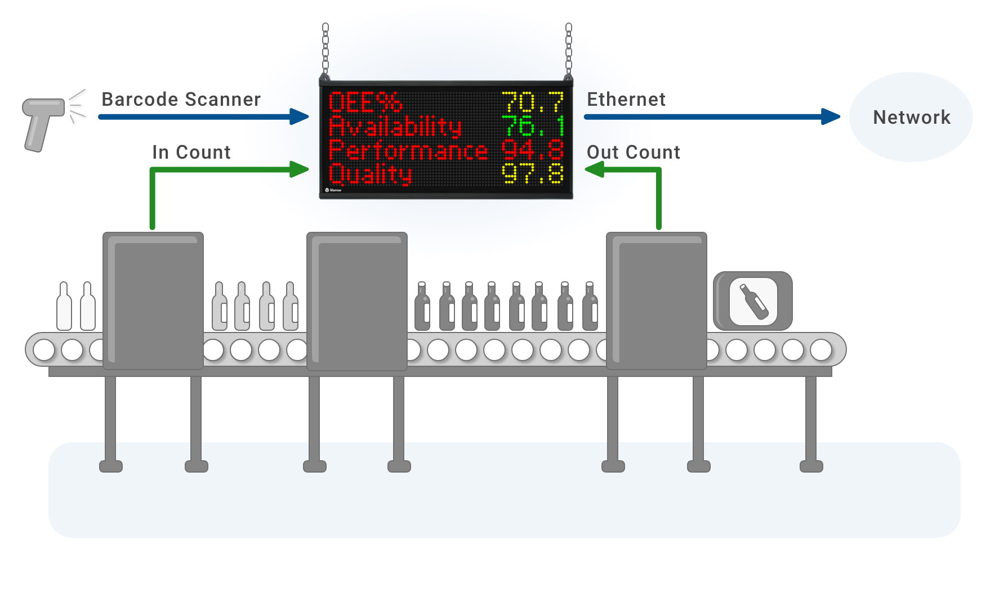
Installation Friendly
Easily installed by your maintenance team.
All you need to be up and running is:
  One or two sensors
  A barcode scanner
  An Ethernet and power drop
Installation can be completed
in a day
Instant access to dozens of built-in reports, configure your own reports in an hour (or less)
Introducing XL Easy
9
www.vorne.com • 1.630.875.3600 • © 2021-2024 Vorne

Slide 10
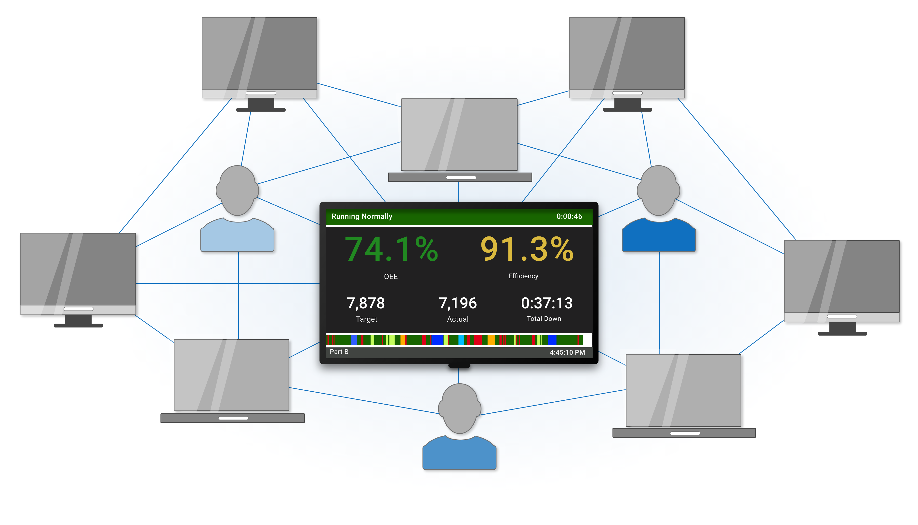
IT Friendly
Little or no impact to IT
No servers or software to install
Operates on your LAN and behind
your firewall
Instant browser-based reporting
Minimal impact to network traffic
Off-the-shelf ERP/MES integration tools
Introducing XL Easy
10
www.vorne.com • 1.630.875.3600 • © 2021-2024 Vorne

Slide 11
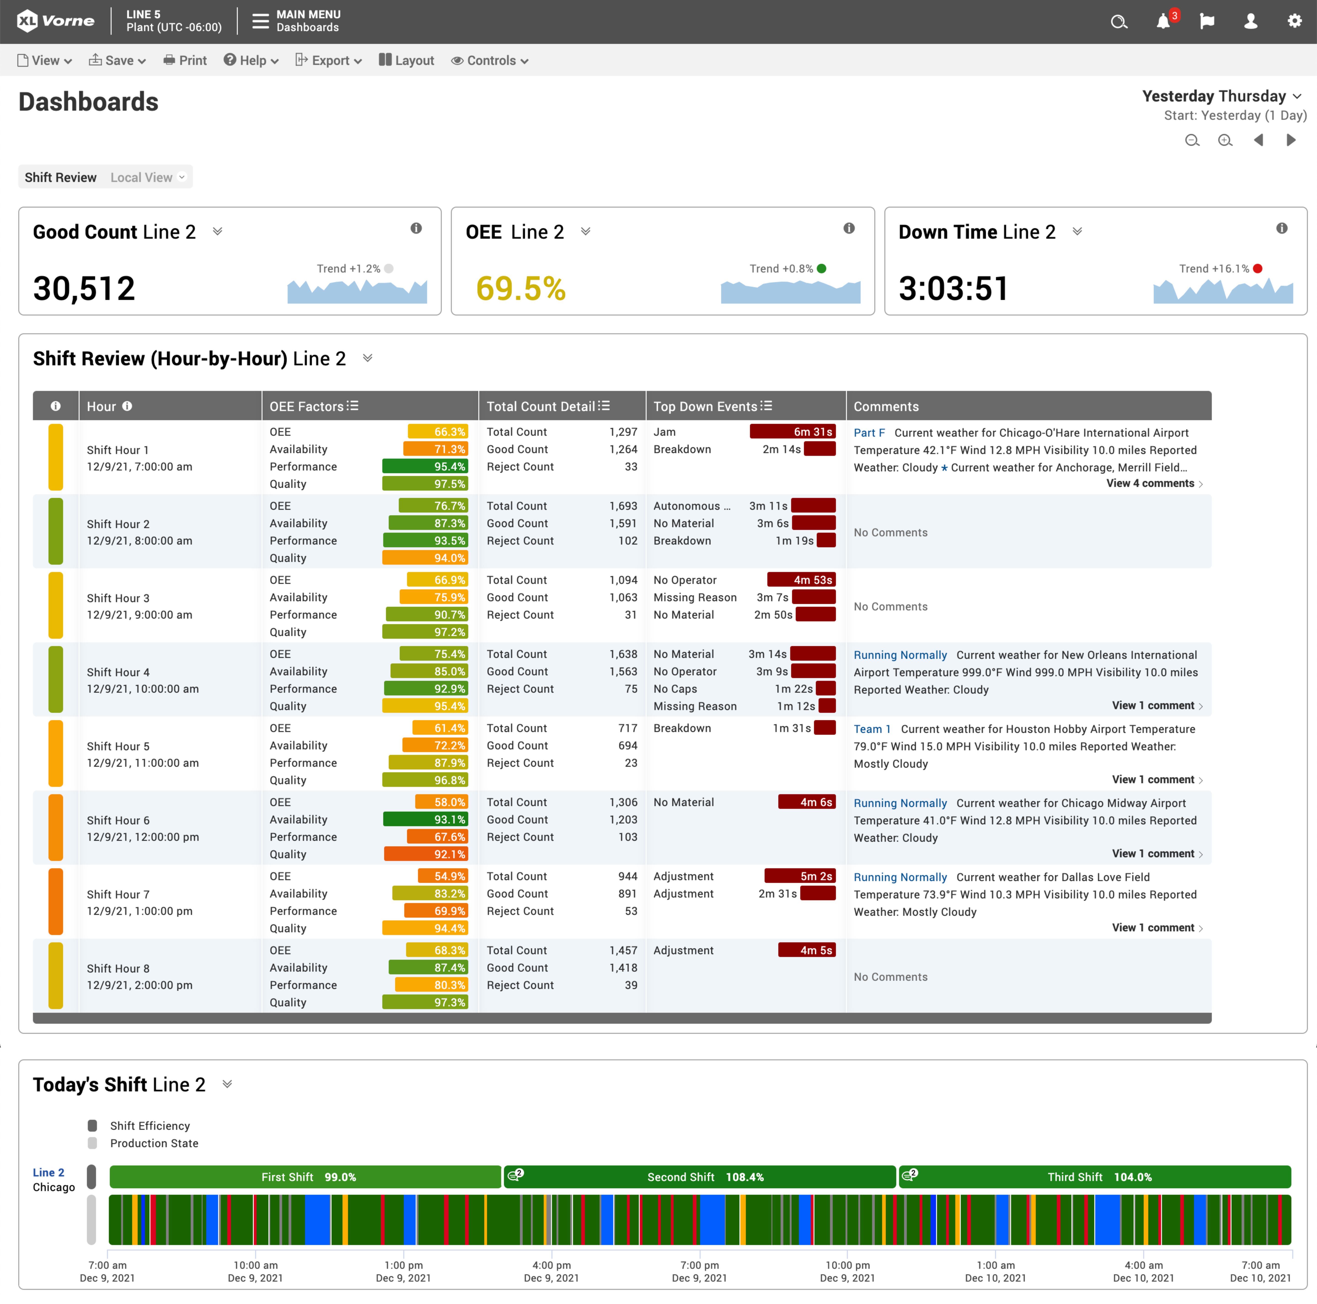
XL Easy
The most important XL feature is
Easy. It’s easy to…
Install: one or two sensors, barcode scanner, Ethernet, power
Configure: point-and-click
Interact: consistent and intuitive reporting platform
Leverage: immediate insights into all types of losses
Expand: add XL devices and data rolls up across your plant
Introducing XL Easy
11
www.vorne.com • 1.630.875.3600 • © 2021-2024 Vorne

Slide 12
What is XL?
Slide 2
Easy
Slide 8
Powerful
Cost-Effective
Slide 29
Succeed with Vorne
Slide 34
Introducing XL Powerful
12
www.vorne.com • 1.630.875.3600 • © 2021-2024 Vorne

Slide 13
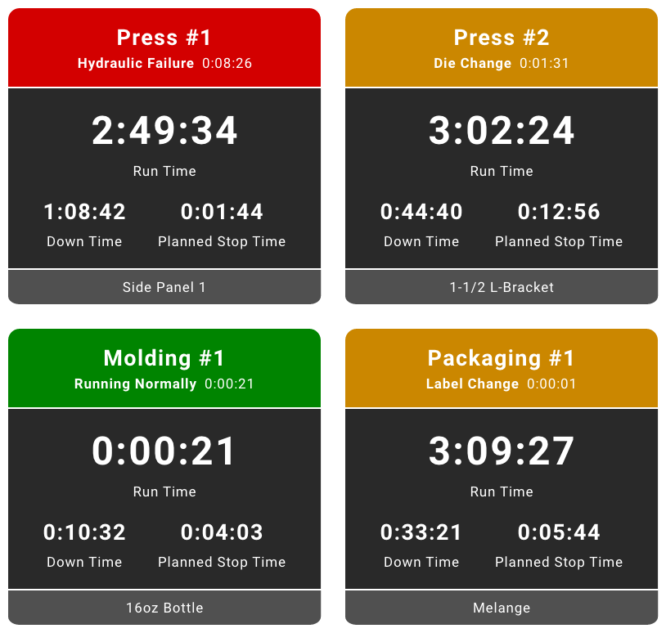
Any Machine
One platform for every process.
Easily applies to all your plants
and all your processes
Provides a consistent view of all your work centers
A unified framework for seeing all production losses
Scales from work center
to enterprise
Introducing XL Powerful
13
www.vorne.com • 1.630.875.3600 • © 2021-2024 Vorne

Slide 14
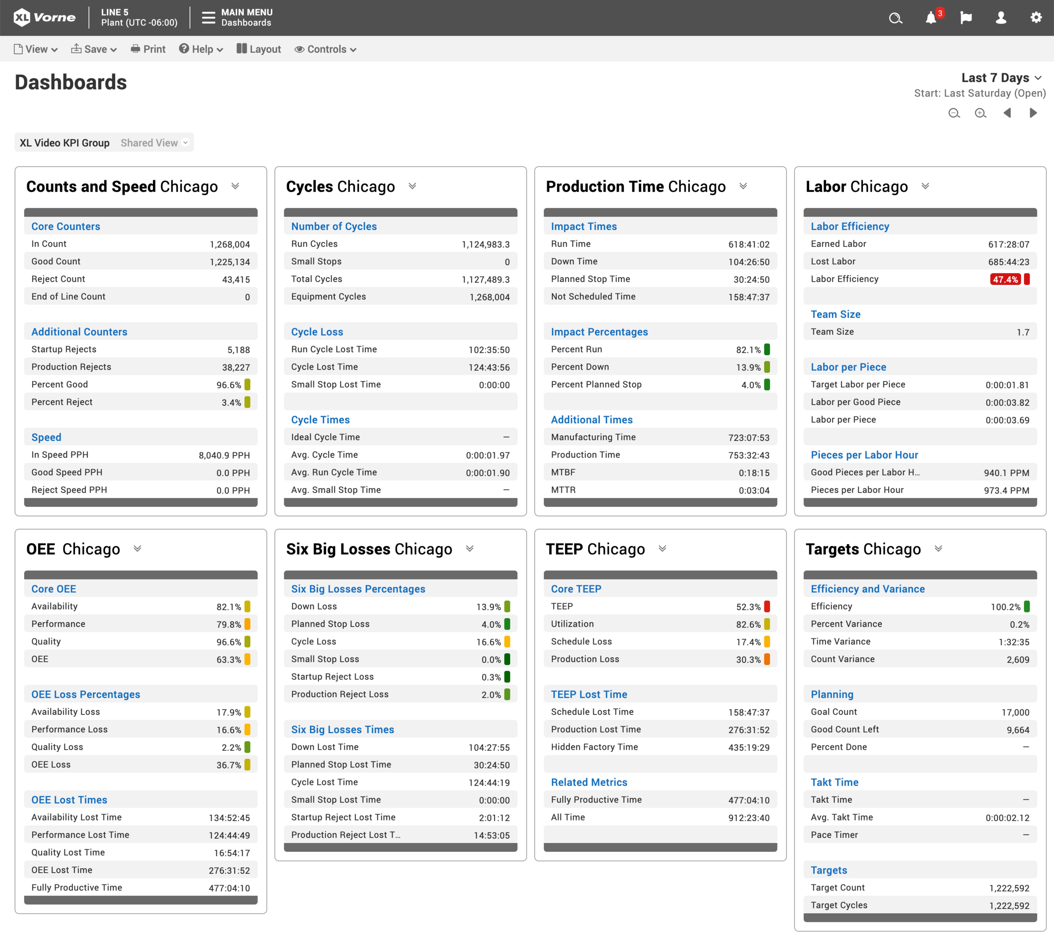
Any Metric
100+ metrics
and dimensions.
Metrics measure a quantitative characteristic of production
  Counts, Rates, Cycles, Quality
  OEE, Six Big Losses, TEEP
  Labor, Targets, Production Times
Dimensions capture a qualitative characteristic of production
  Enterprise, Site, Area,
  Work Center
  Shift, Team, Part, Job
  Production State, Impact, Production Phase,
  Reject Reason
  Shift Hour, Day, Week, Month, Quarter, Year
Introducing XL Powerful
14
www.vorne.com • 1.630.875.3600 • © 2021-2024 Vorne

Slide 15
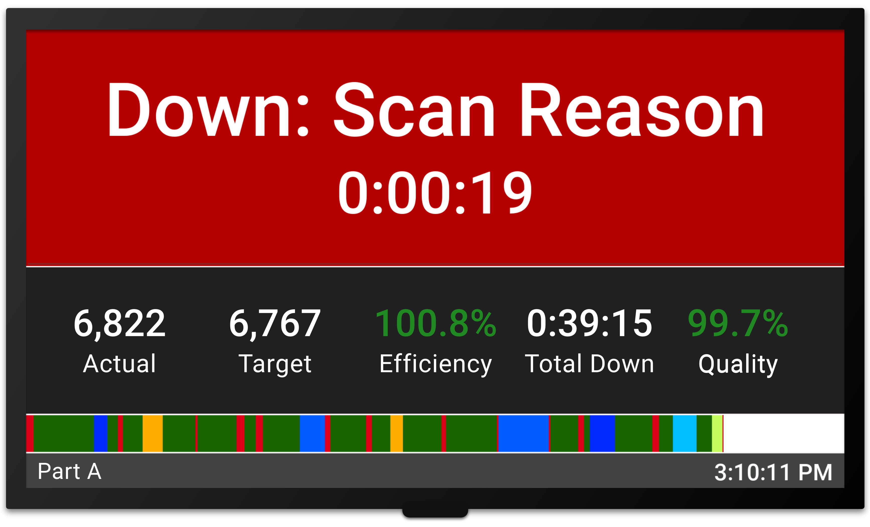
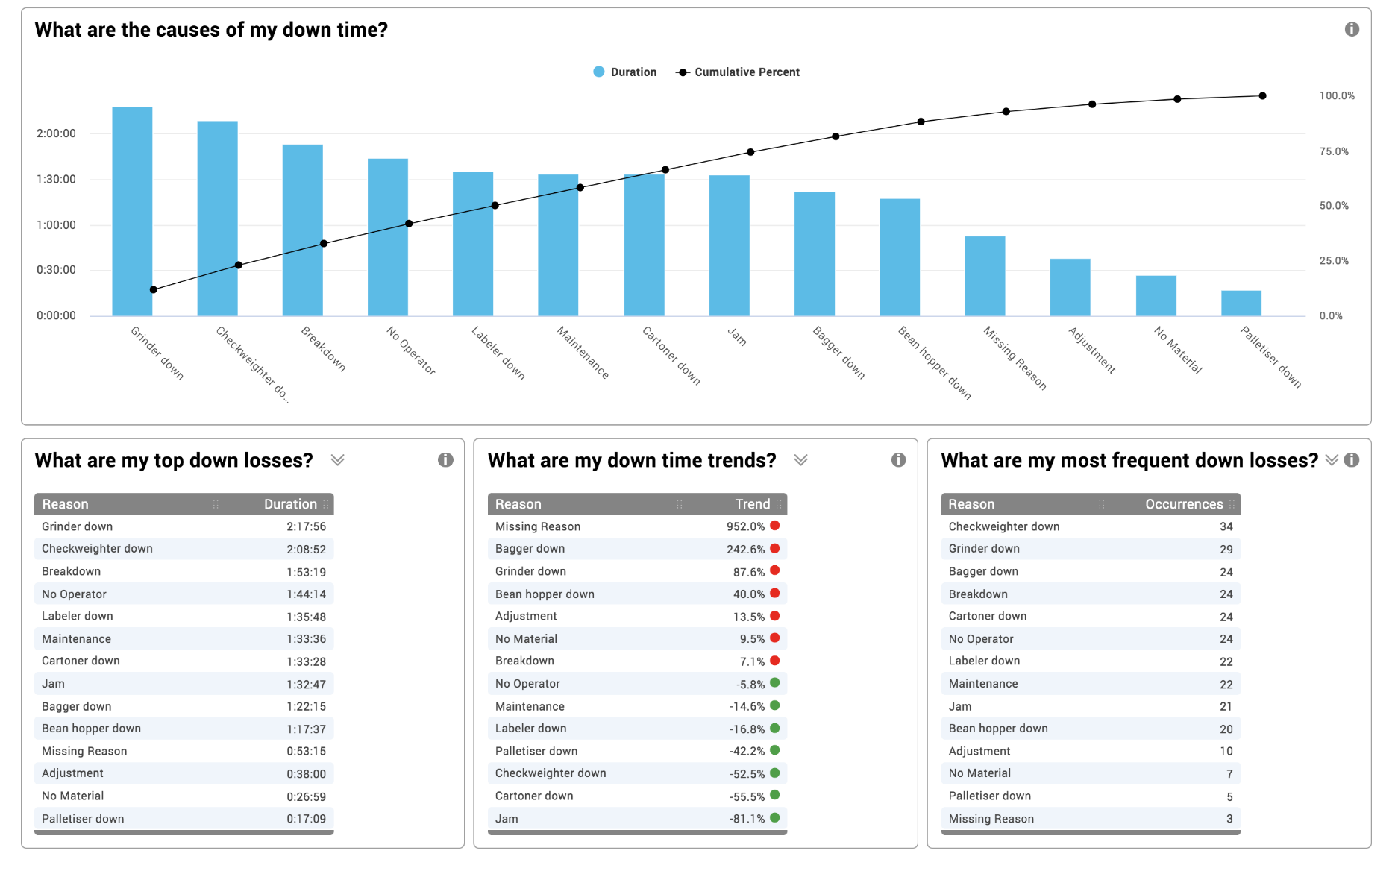
Track Downtime
Automated. Accurate. Actionable.
Scoreboard for Operators
Replaces highly inaccurate manual
log sheets
Automatic, precise, run/down detector
Operators are prompted to scan reasons for in-depth analytics
Add comments to key events to capture additional insights
Companies are often shocked when they discover their true down time
Factors into OEE Availability (together with changeovers)
Reports for Your Entire Team
Introducing XL Powerful
15
www.vorne.com • 1.630.875.3600 • © 2021-2024 Vorne

Slide 16
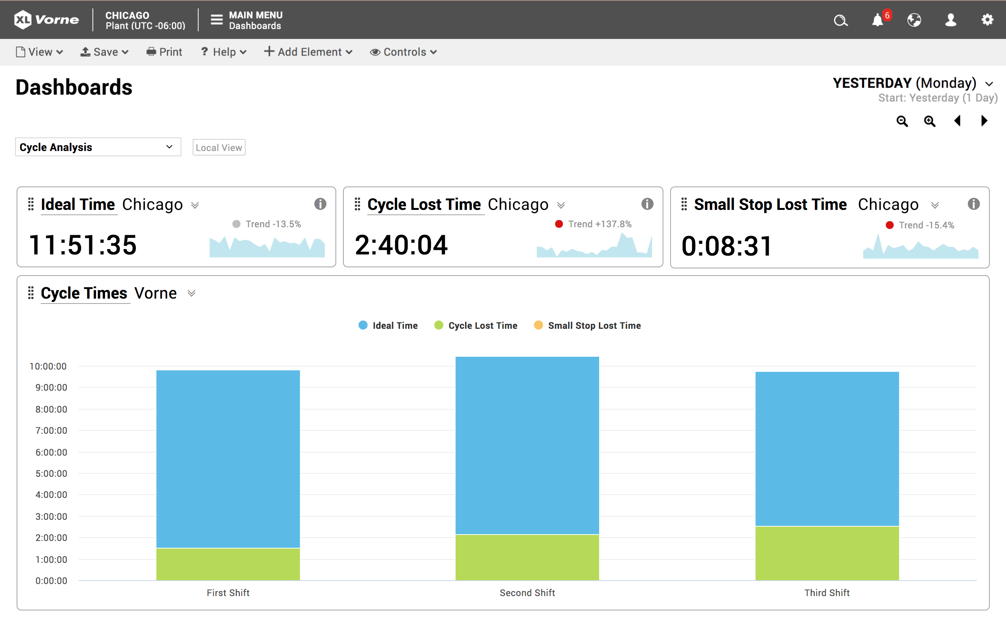
Analyze Cycles
Precisely measure run cycles
and small stops.
Automatically measures and categorizes every cycle
Deep analytics with 18 built-in
cycle metrics
Validate run cycles to ideal cycle time for accurate OEE scores
Small stops are differentiated as they often have a different root cause
Equipment cycles tracked for asset-care programs
Factors into OEE Performance
Introducing XL Powerful
16
www.vorne.com • 1.630.875.3600 • © 2021-2024 Vorne

Slide 17
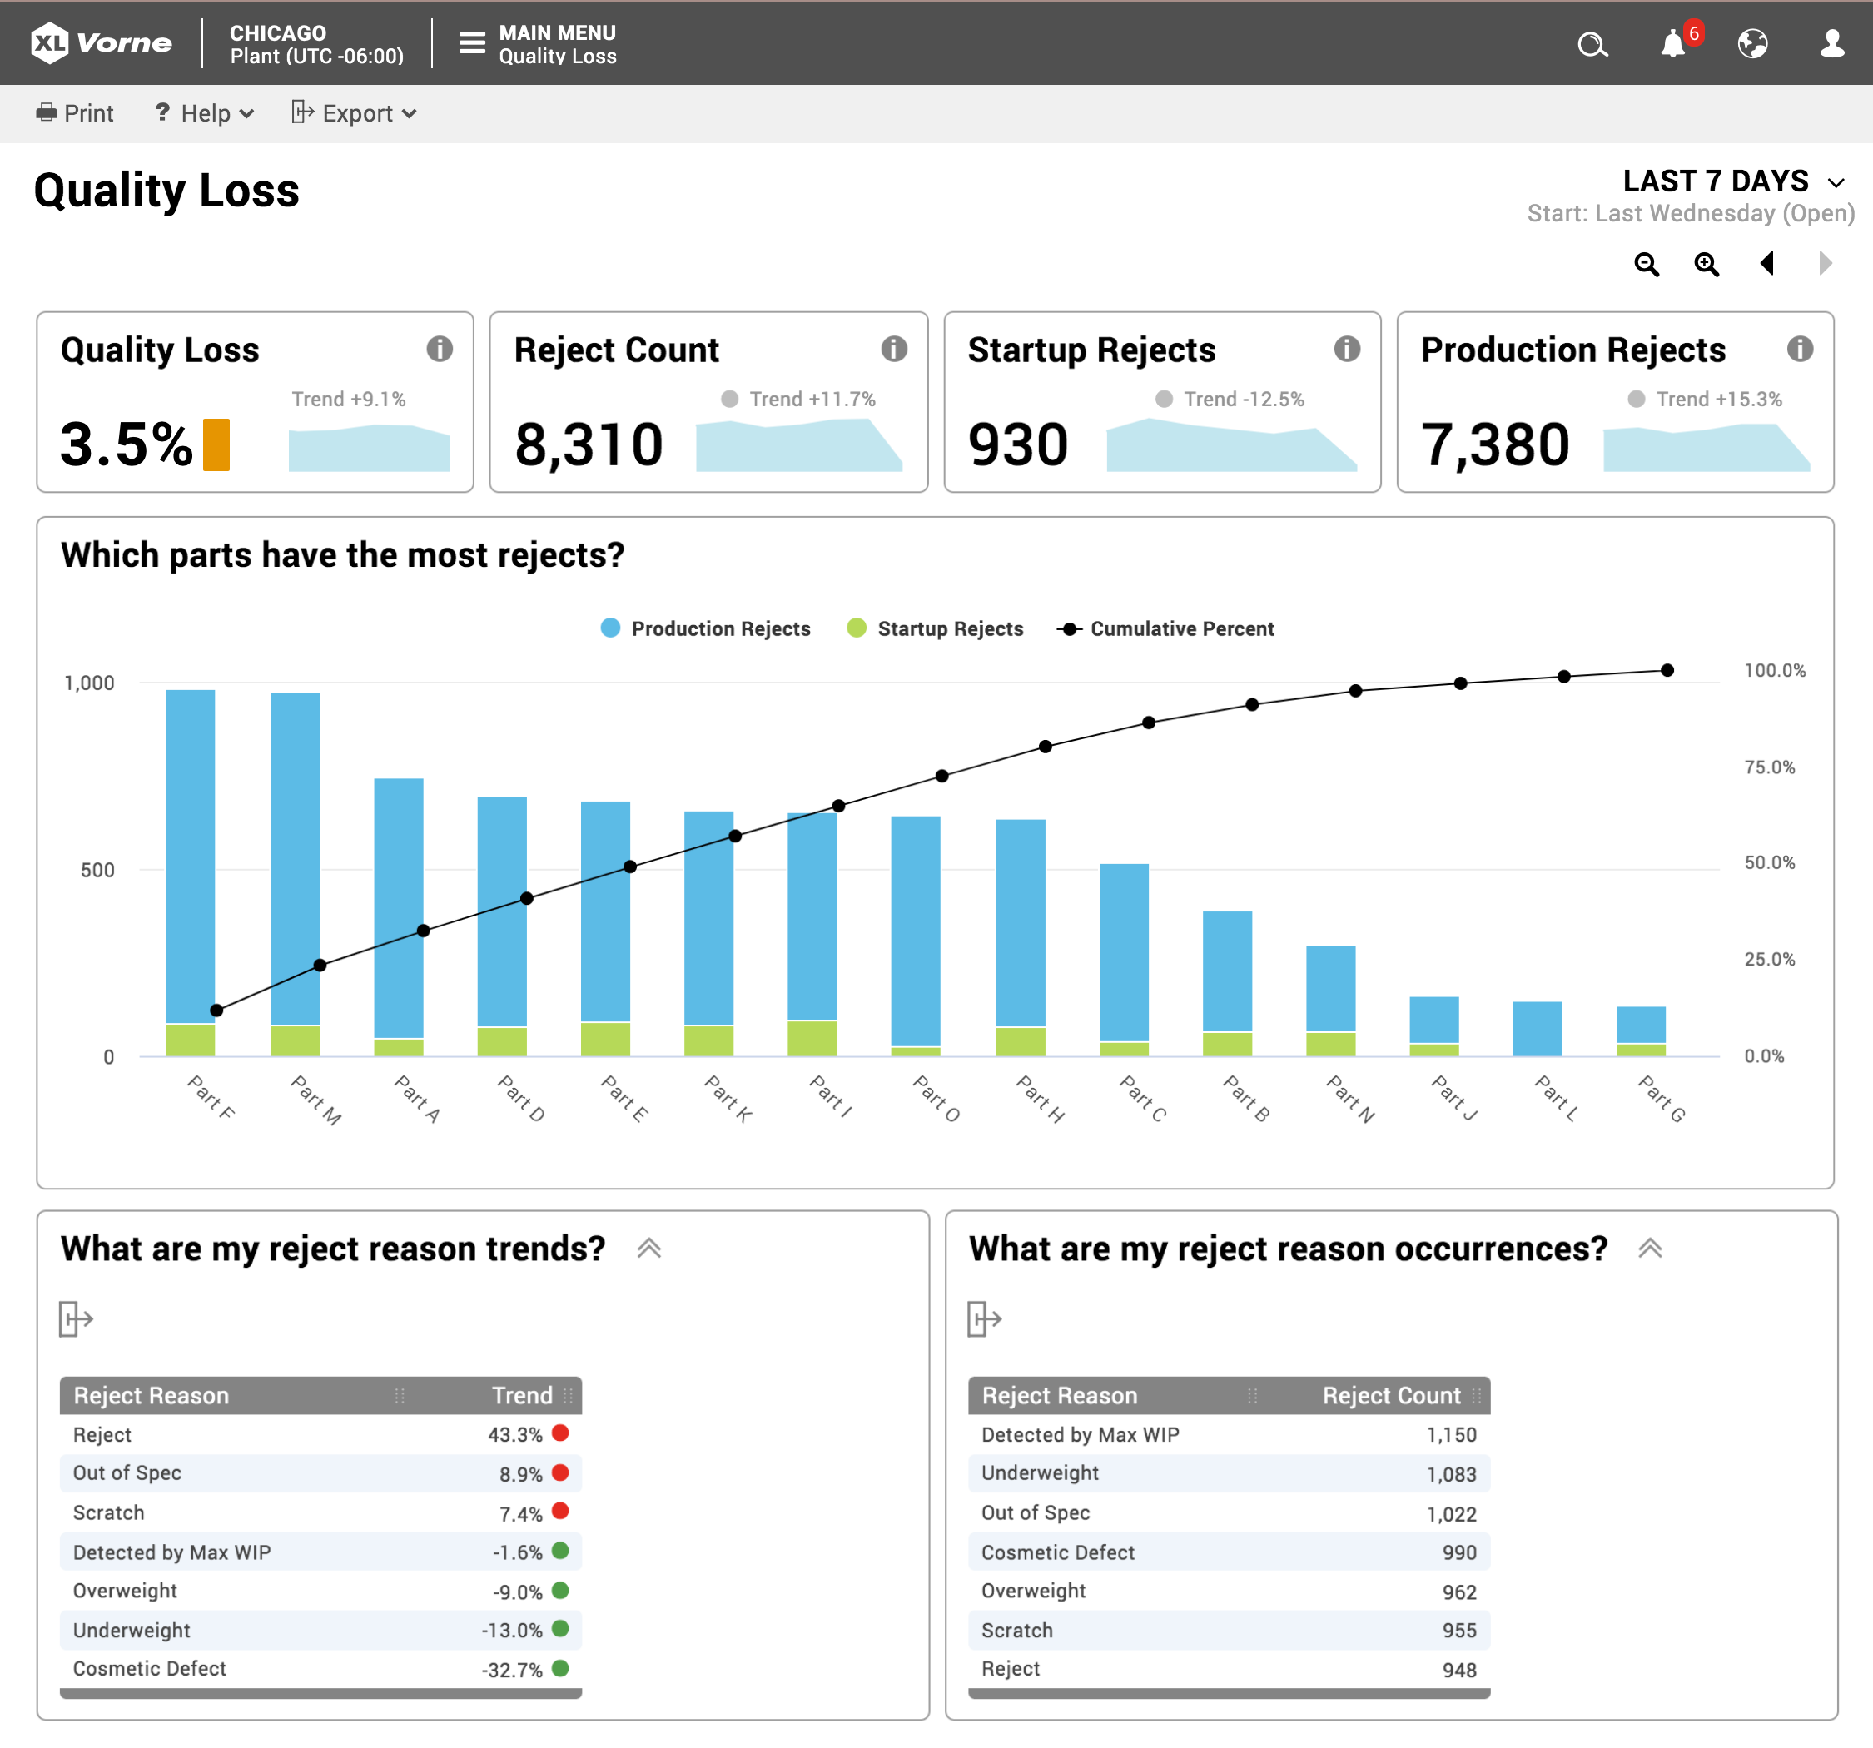
Explore Quality
Quantify quality metrics and reject reasons.
Automatically track startup and production rejects
Identify emerging issues with trend analytics
Scan reject reasons for root
cause analysis
Use dimensional analysis to better understand underlying causes
Factors into OEE Quality
Introducing XL Powerful
17
www.vorne.com • 1.630.875.3600 • © 2021-2024 Vorne

Slide 18
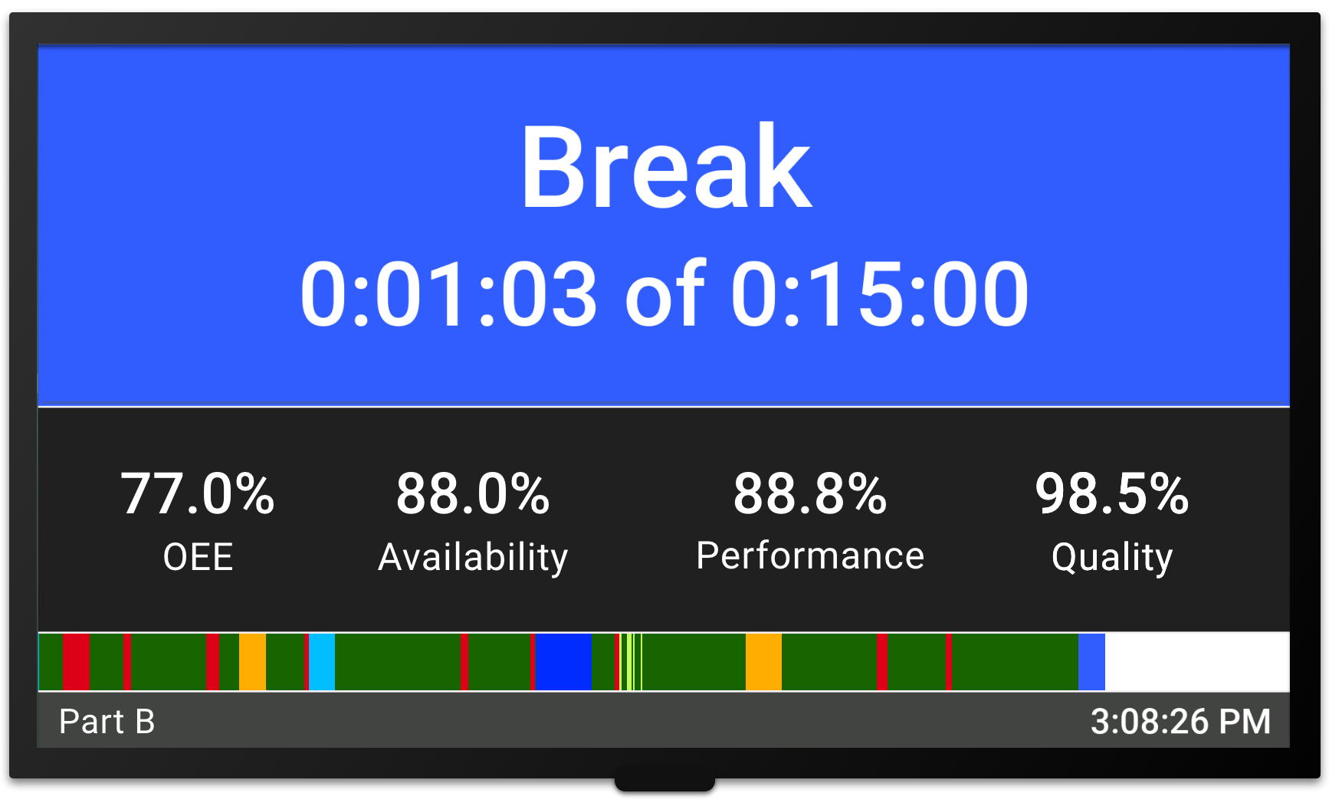
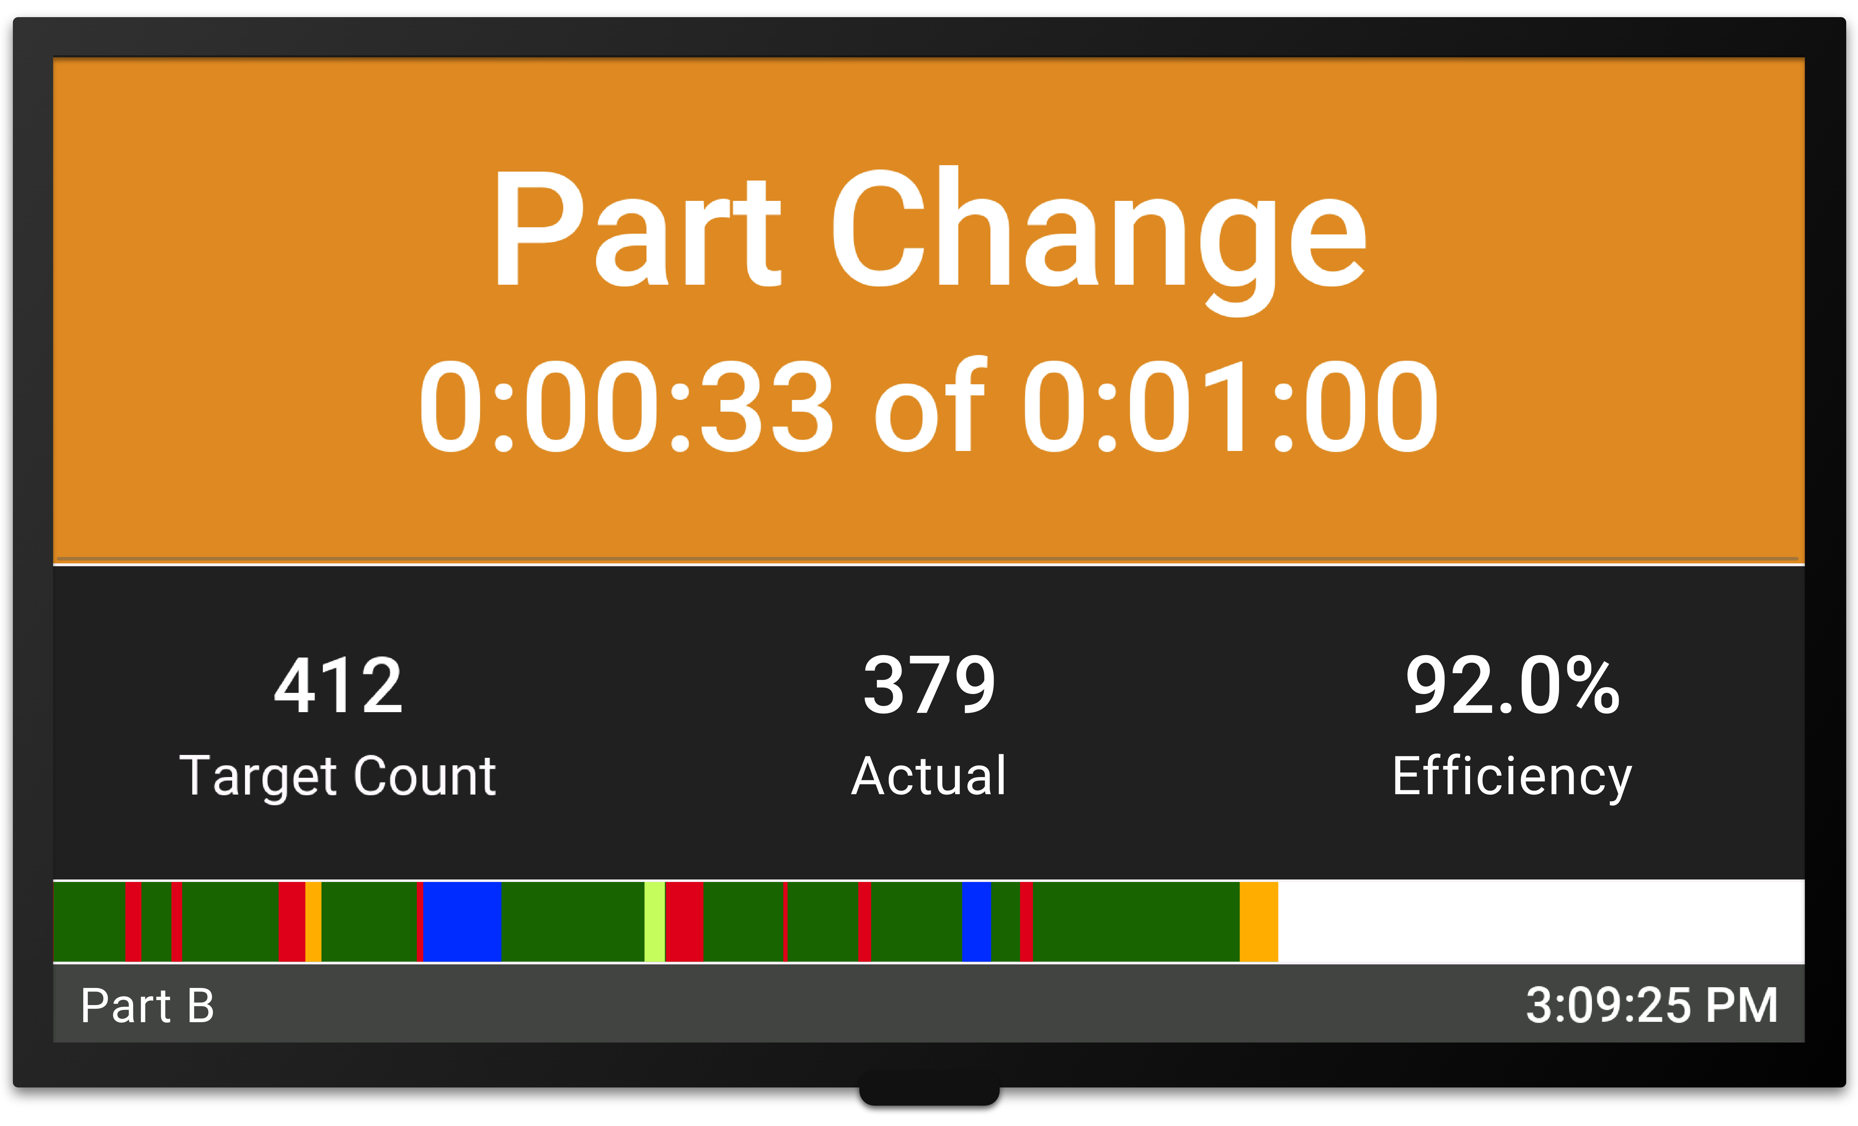
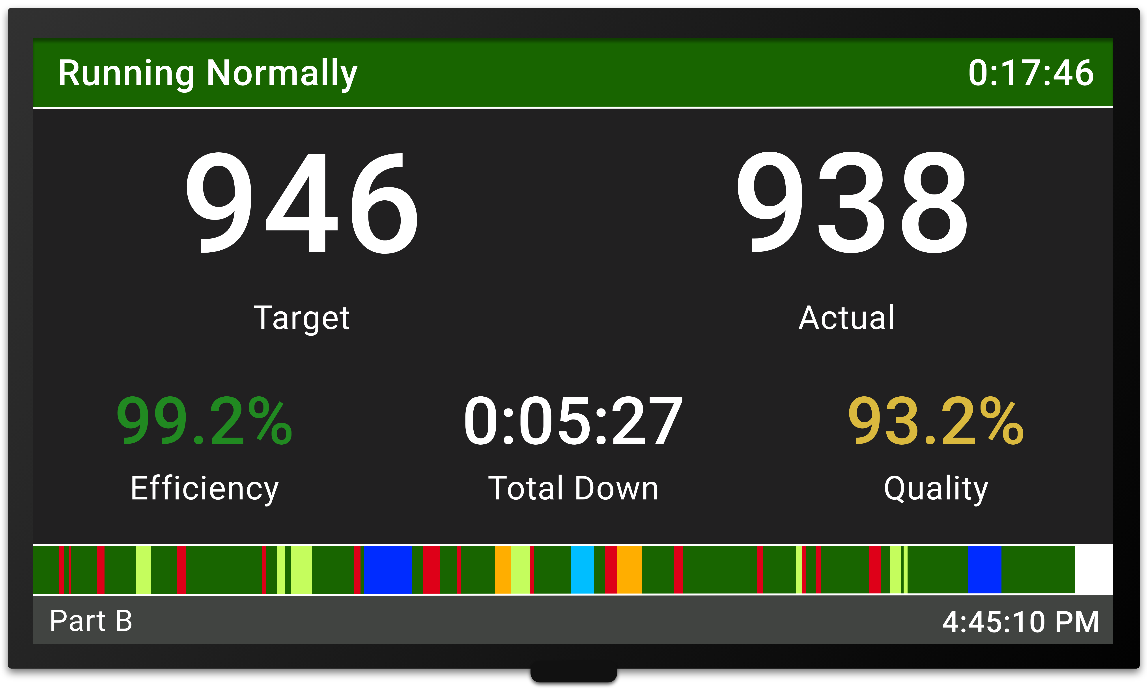
Visual Factory
Empower your plant floor team.
Production State Screens
Immediately improve productivity with real-time targets for operators
Choose from 100+ KPIs with point-and-click scoreboard configuration
TAED (Target, Actual, Efficiency, Down) is often used so operators can “win the shift”
Scoreboard automatically changes context (e.g., down, changeovers, breaks)
Running Normally
Introducing XL Powerful
18
www.vorne.com • 1.630.875.3600 • © 2021-2024 Vorne

Slide 19
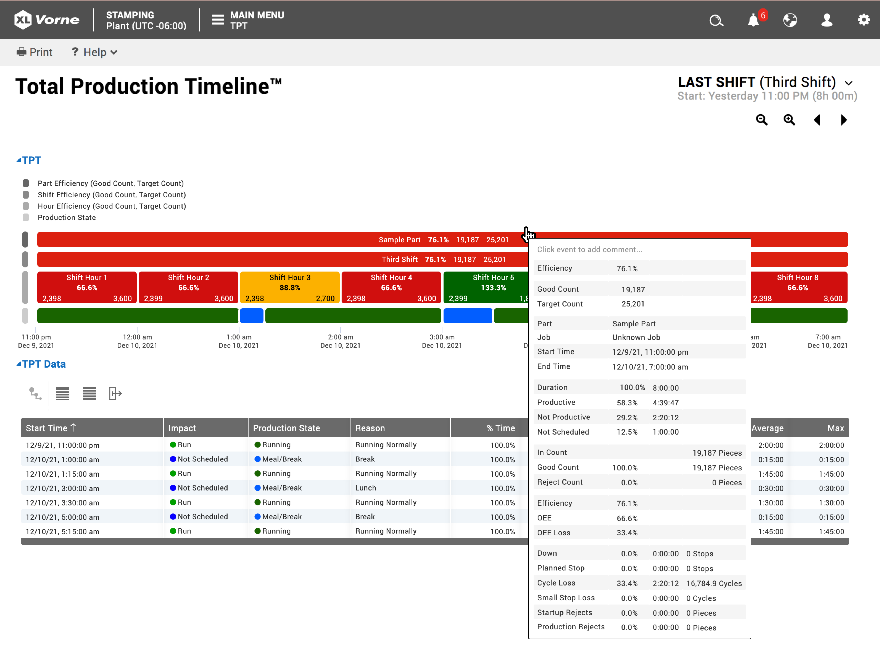
Visualize Production
A real-time view of manufacturing.
View production data for any work center from anywhere on your network
Visualize production in real time during the shift
Color-coded events expose issues, identify patterns, and encourage action
Instantly see downtime, changeovers, production, and breaks
Tooltips provide complete loss reports for every event
Add comments to events of interest
Introducing XL Powerful
19
www.vorne.com • 1.630.875.3600 • © 2021-2024 Vorne

Slide 20
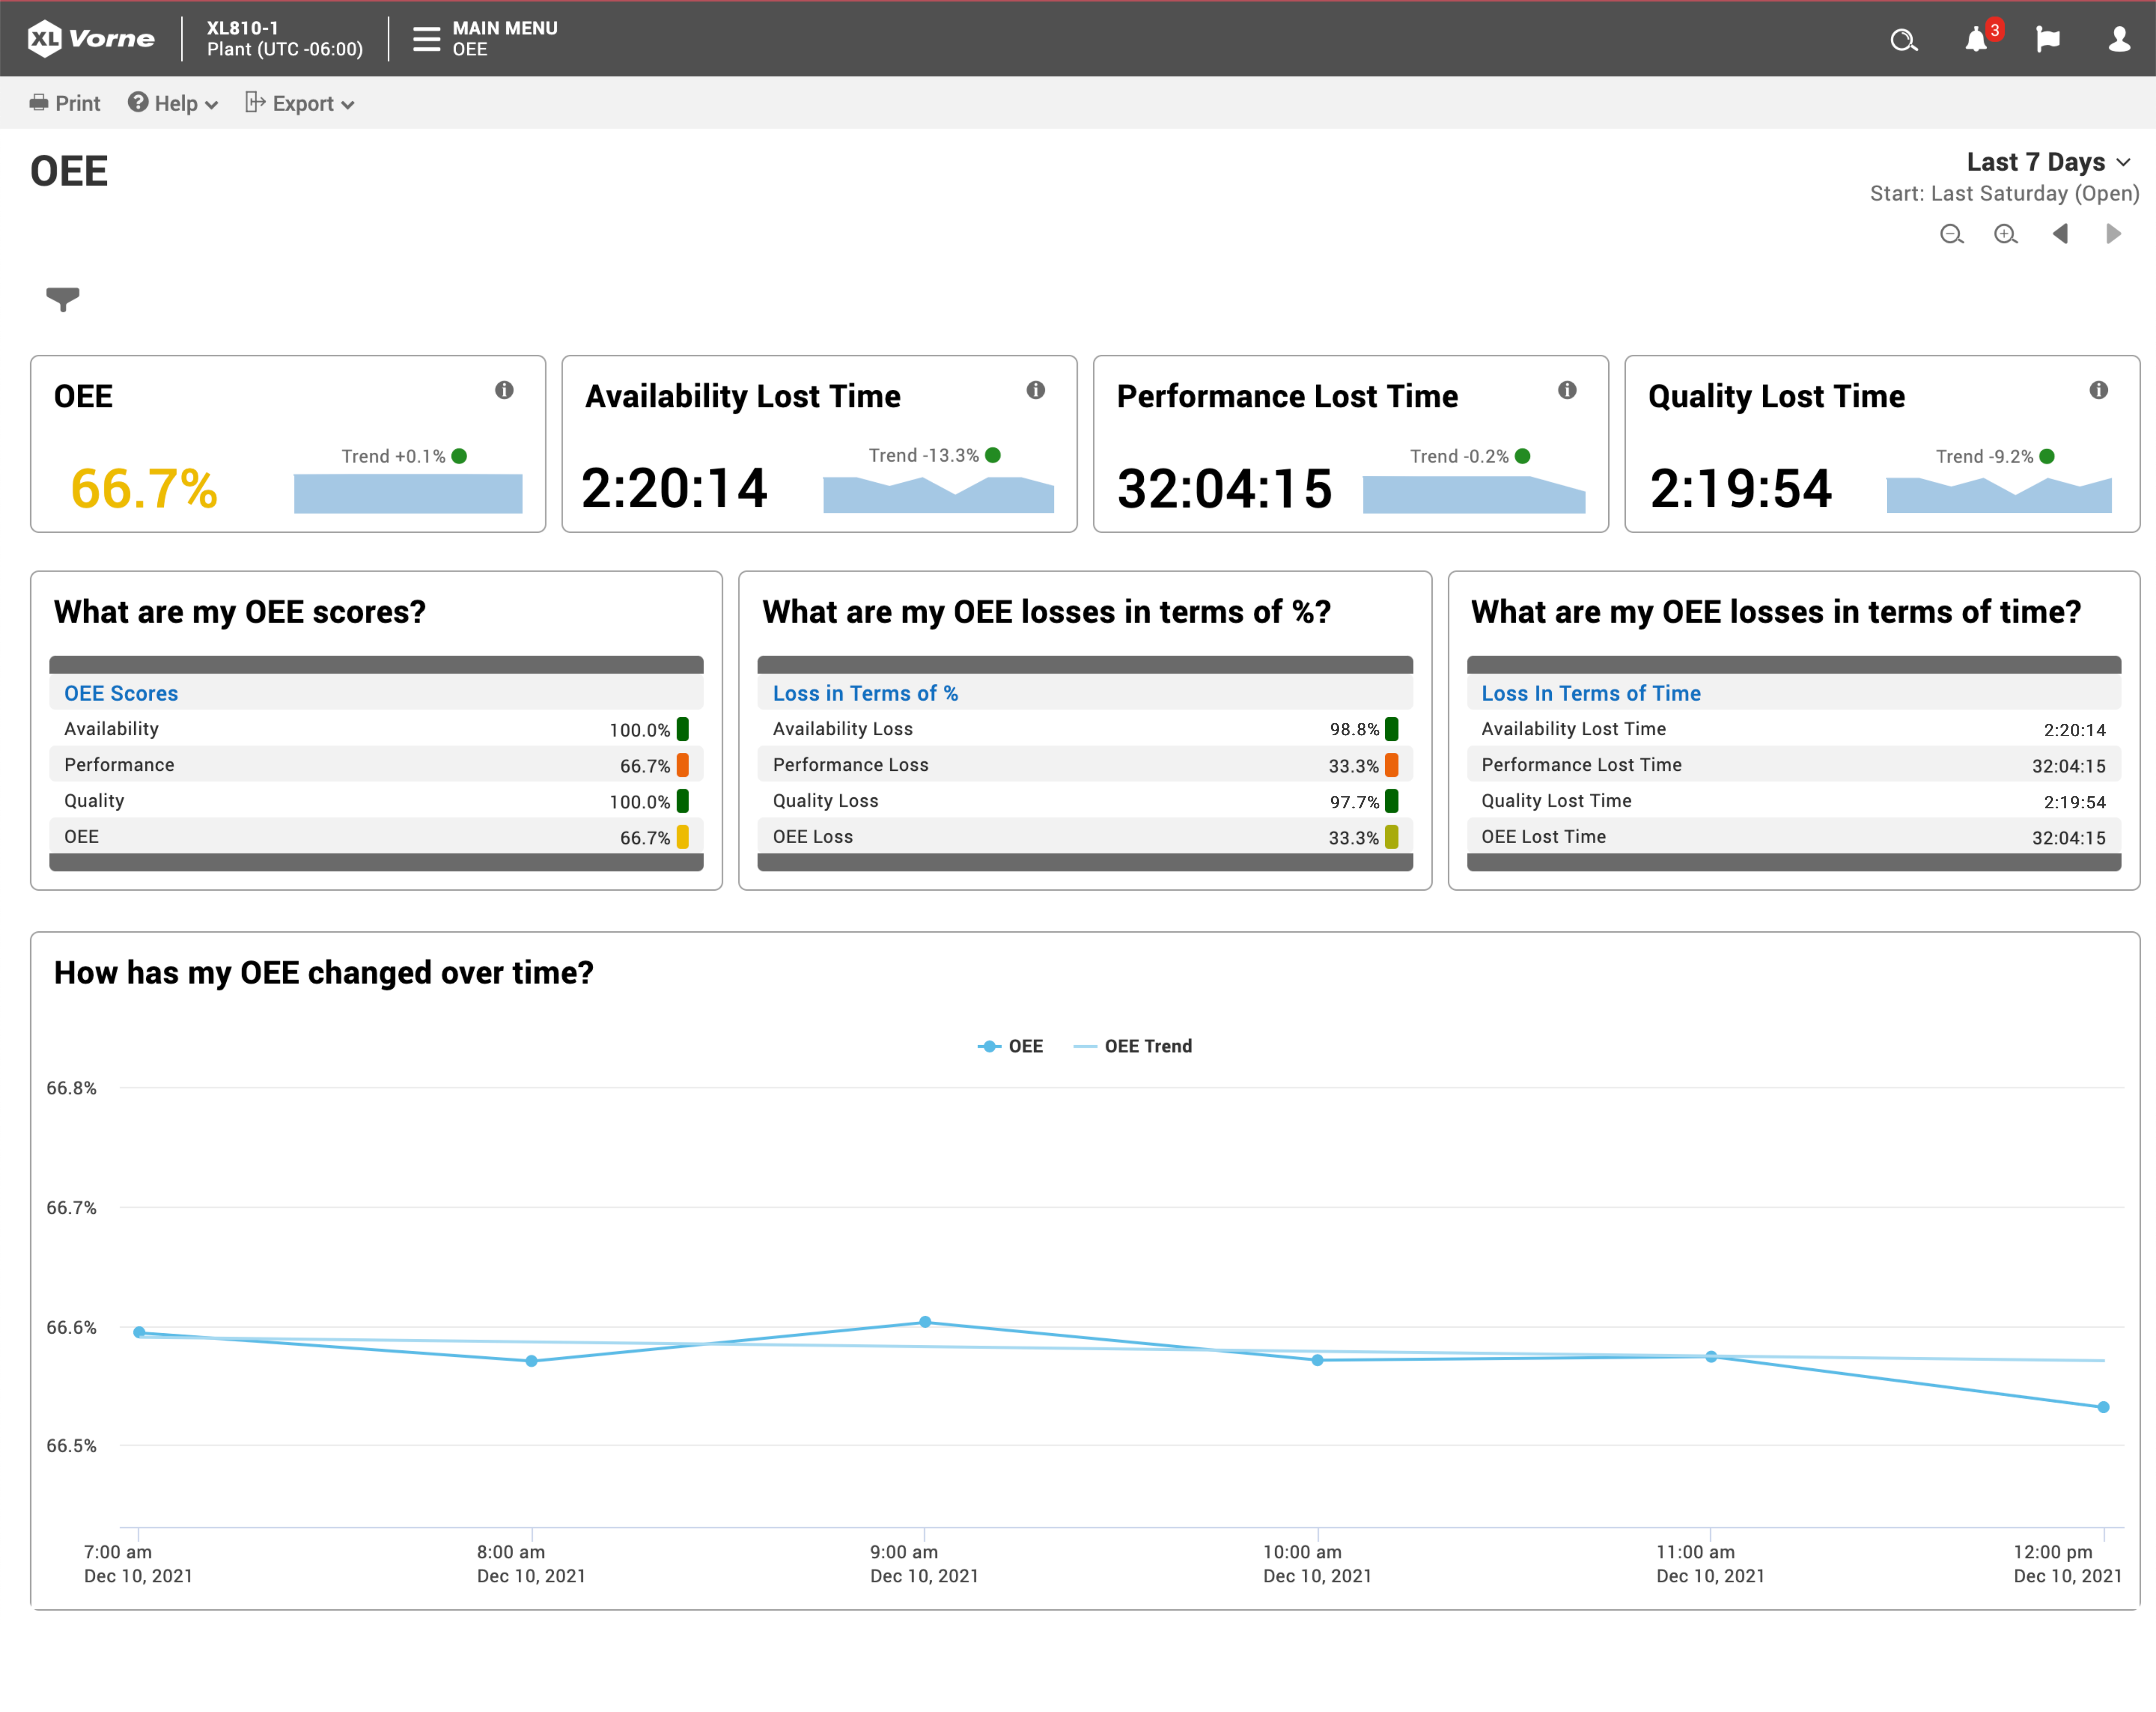
Instant OEE
The gold standard for manufacturing productivity.
OEE delivered by the publishers
of oee.com
Six Big Loss reports delivered by the publishers of leanproduction.com
TEEP reports to expose your
“hidden factory”
Introducing XL Powerful
20
www.vorne.com • 1.630.875.3600 • © 2021-2024 Vorne

Slide 21
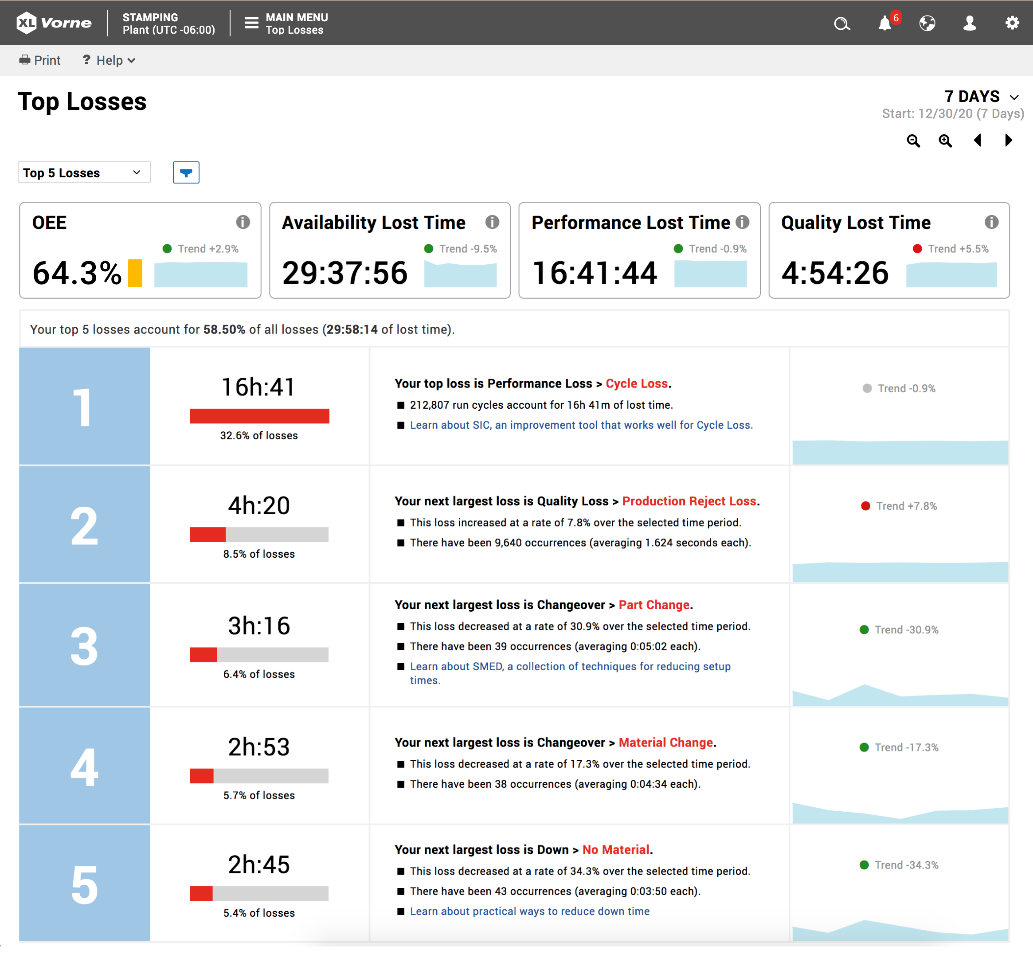
Top Losses
Your built-in continuous
improvement roadmap.
Losses prioritized and ranked
by their time impact
Sparklines show trends and patterns
Additional details and context for each loss
Provides instant clarity on what to fix next
Spend more time improving and less time in meetings
Justify actions with data
Introducing XL Powerful
21
www.vorne.com • 1.630.875.3600 • © 2021-2024 Vorne

Slide 22
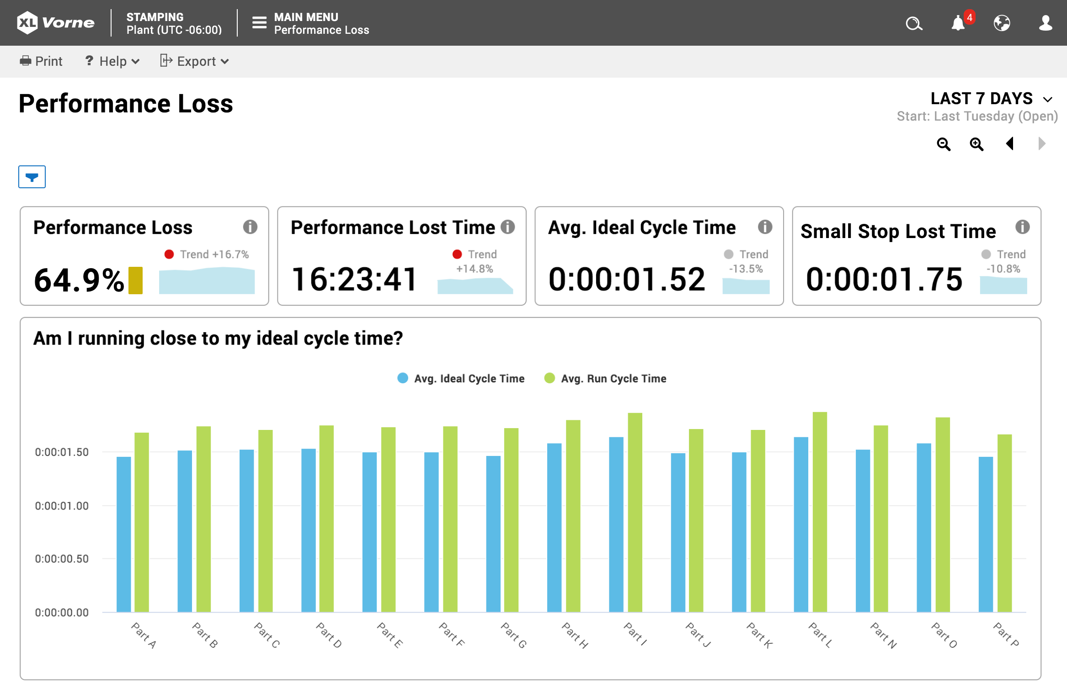
Take a Deep Dive
Instant answers to important questions.
Simple: Q&A format
Natural: easy phrasing, such as “Am I running close to my ideal cycle time?”
Powerful: based on best practices from thousands of deployments
Productivity: OEE, Six Big Losses, TEEP
Losses: Down Time, Changeover, Performance Loss, Quality Loss
Labor: Teams and Labor
Introducing XL Powerful
22
www.vorne.com • 1.630.875.3600 • © 2021-2024 Vorne

Slide 23
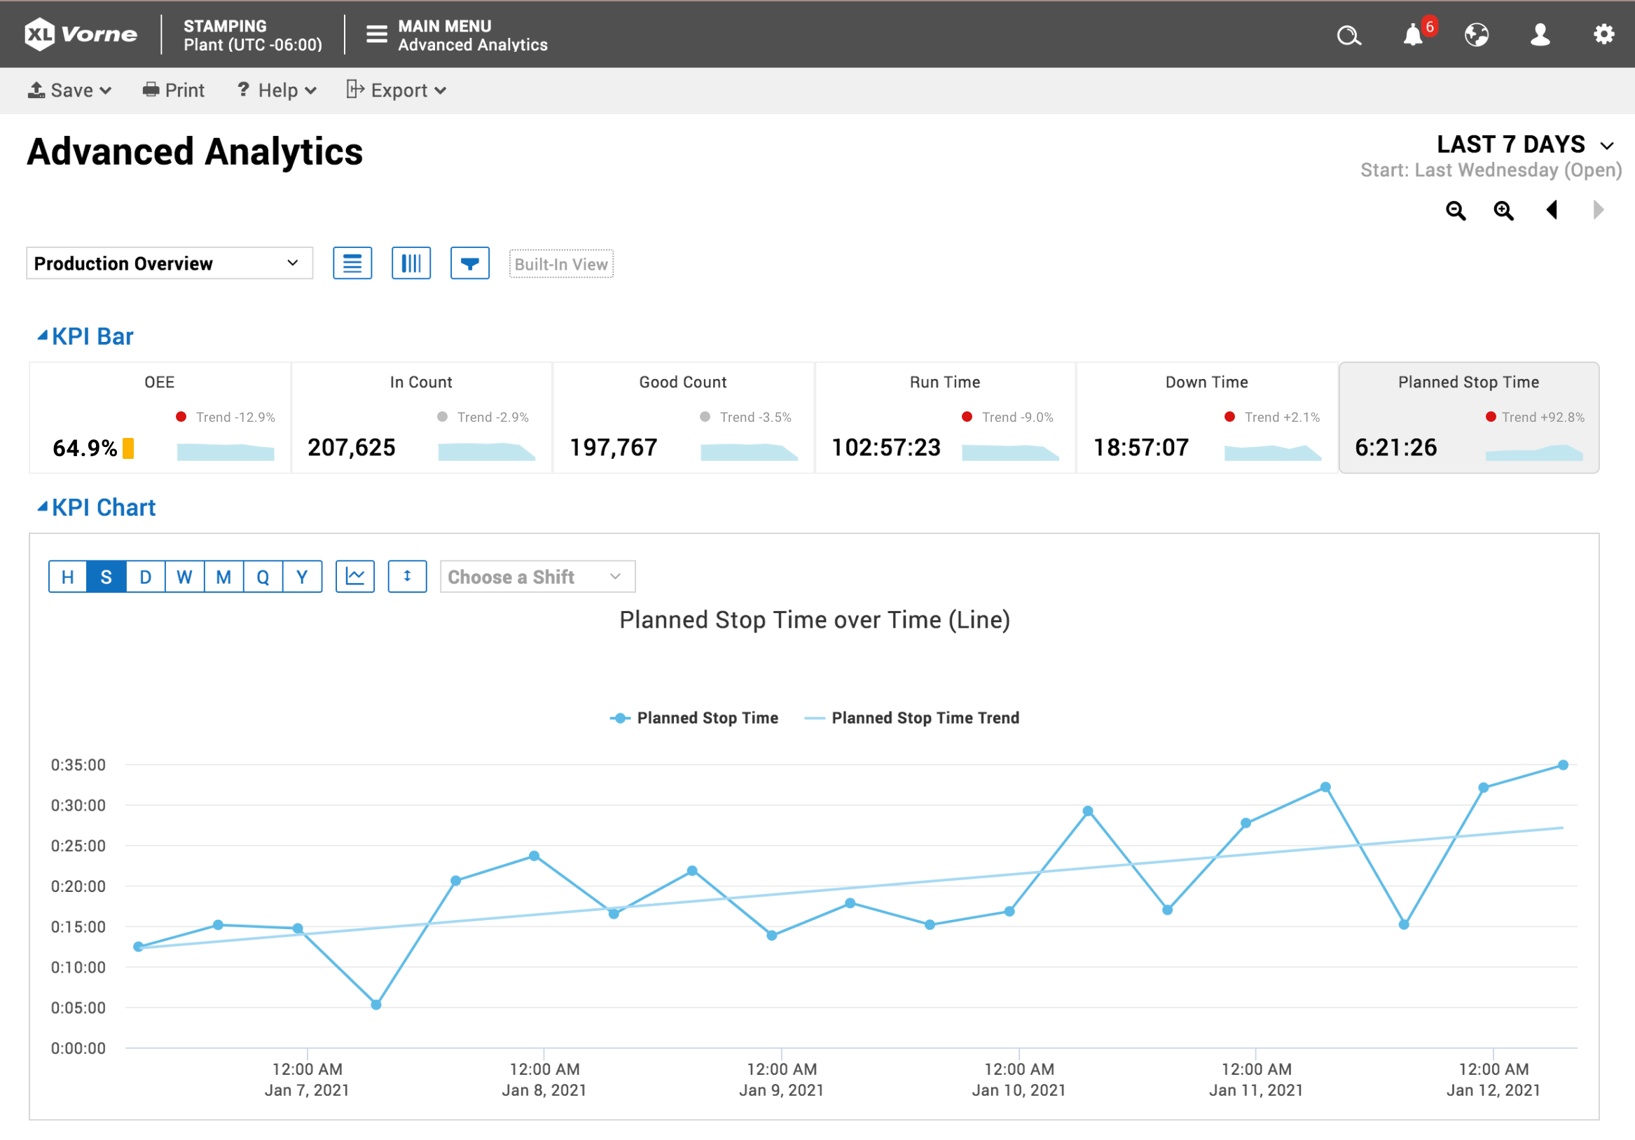
Advanced Analytics
Analyze trends to see which KPIs are improving.
Explore dimensions and metrics with an intuitive drag-and-drop interface
Compare across dimensions to discover connections and causality
Trend metrics to see which KPIs are improving and which are getting worse
Review the impact of your actions with focused, personalized views
Introducing XL Powerful
23
www.vorne.com • 1.630.875.3600 • © 2021-2024 Vorne

Slide 24
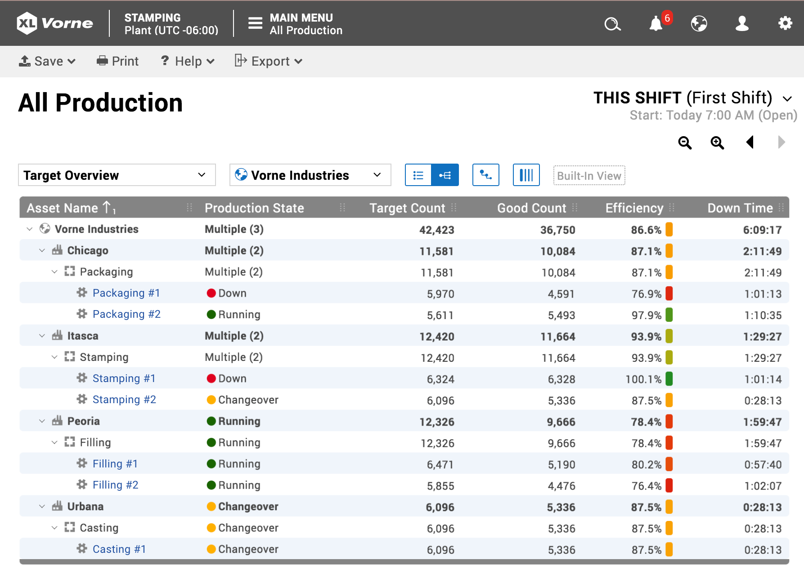
All Production
Your entire enterprise at a glance.
A complete hierarchical view of
sites, areas, and work centers
Automatic rollup of data across
all levels
Color calls attention to where action
is needed
Multiple built-in views or configure your own
All this with no servers, no software to install, and no recurring fees
Introducing XL Powerful
24
www.vorne.com • 1.630.875.3600 • © 2021-2024 Vorne

Slide 25
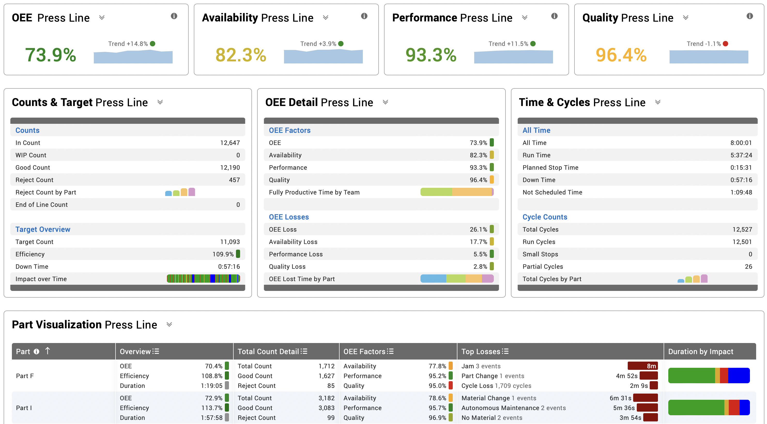
Live Dashboards
Point-and-click to create your own reports.
Personalize views or define standard company views
Incorporate Andon, Chart, Chronogram, Event List, Table, Top Losses Table, Pivot Table, KPI, and KPI Group widgets
Instantly export any table to Excel
Exactly what you want to see, exactly how you want to see it
Introducing XL Powerful
25
www.vorne.com • 1.630.875.3600 • © 2021-2024 Vorne

Slide 26
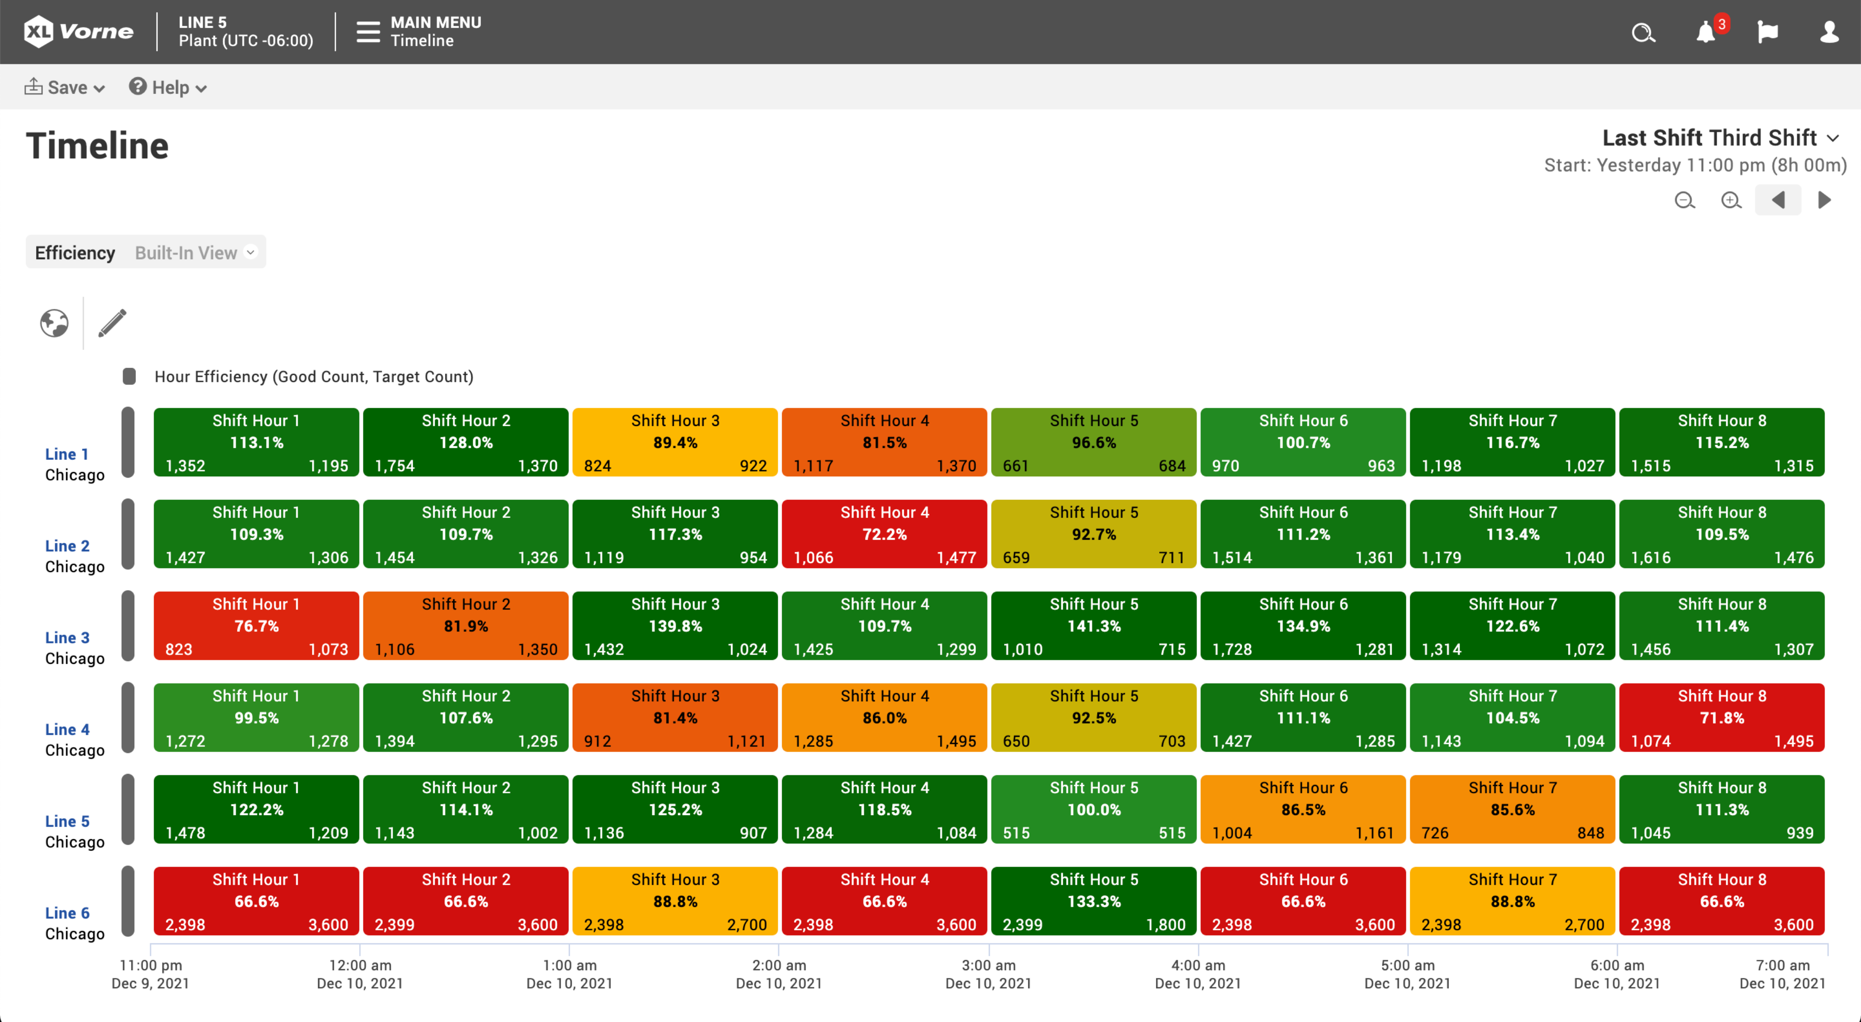
Heat Maps
Problems immediately leap from the page.
Quickly scan and instantly spot problems
Available for Charts, Tables, Event Lists, and Chronograms
Define levels for each alert metric: Good, Caution, Warning, Critical
Continuous color gradients create highly expressive reports
Introducing XL Powerful
26
www.vorne.com • 1.630.875.3600 • © 2021-2024 Vorne

Slide 27
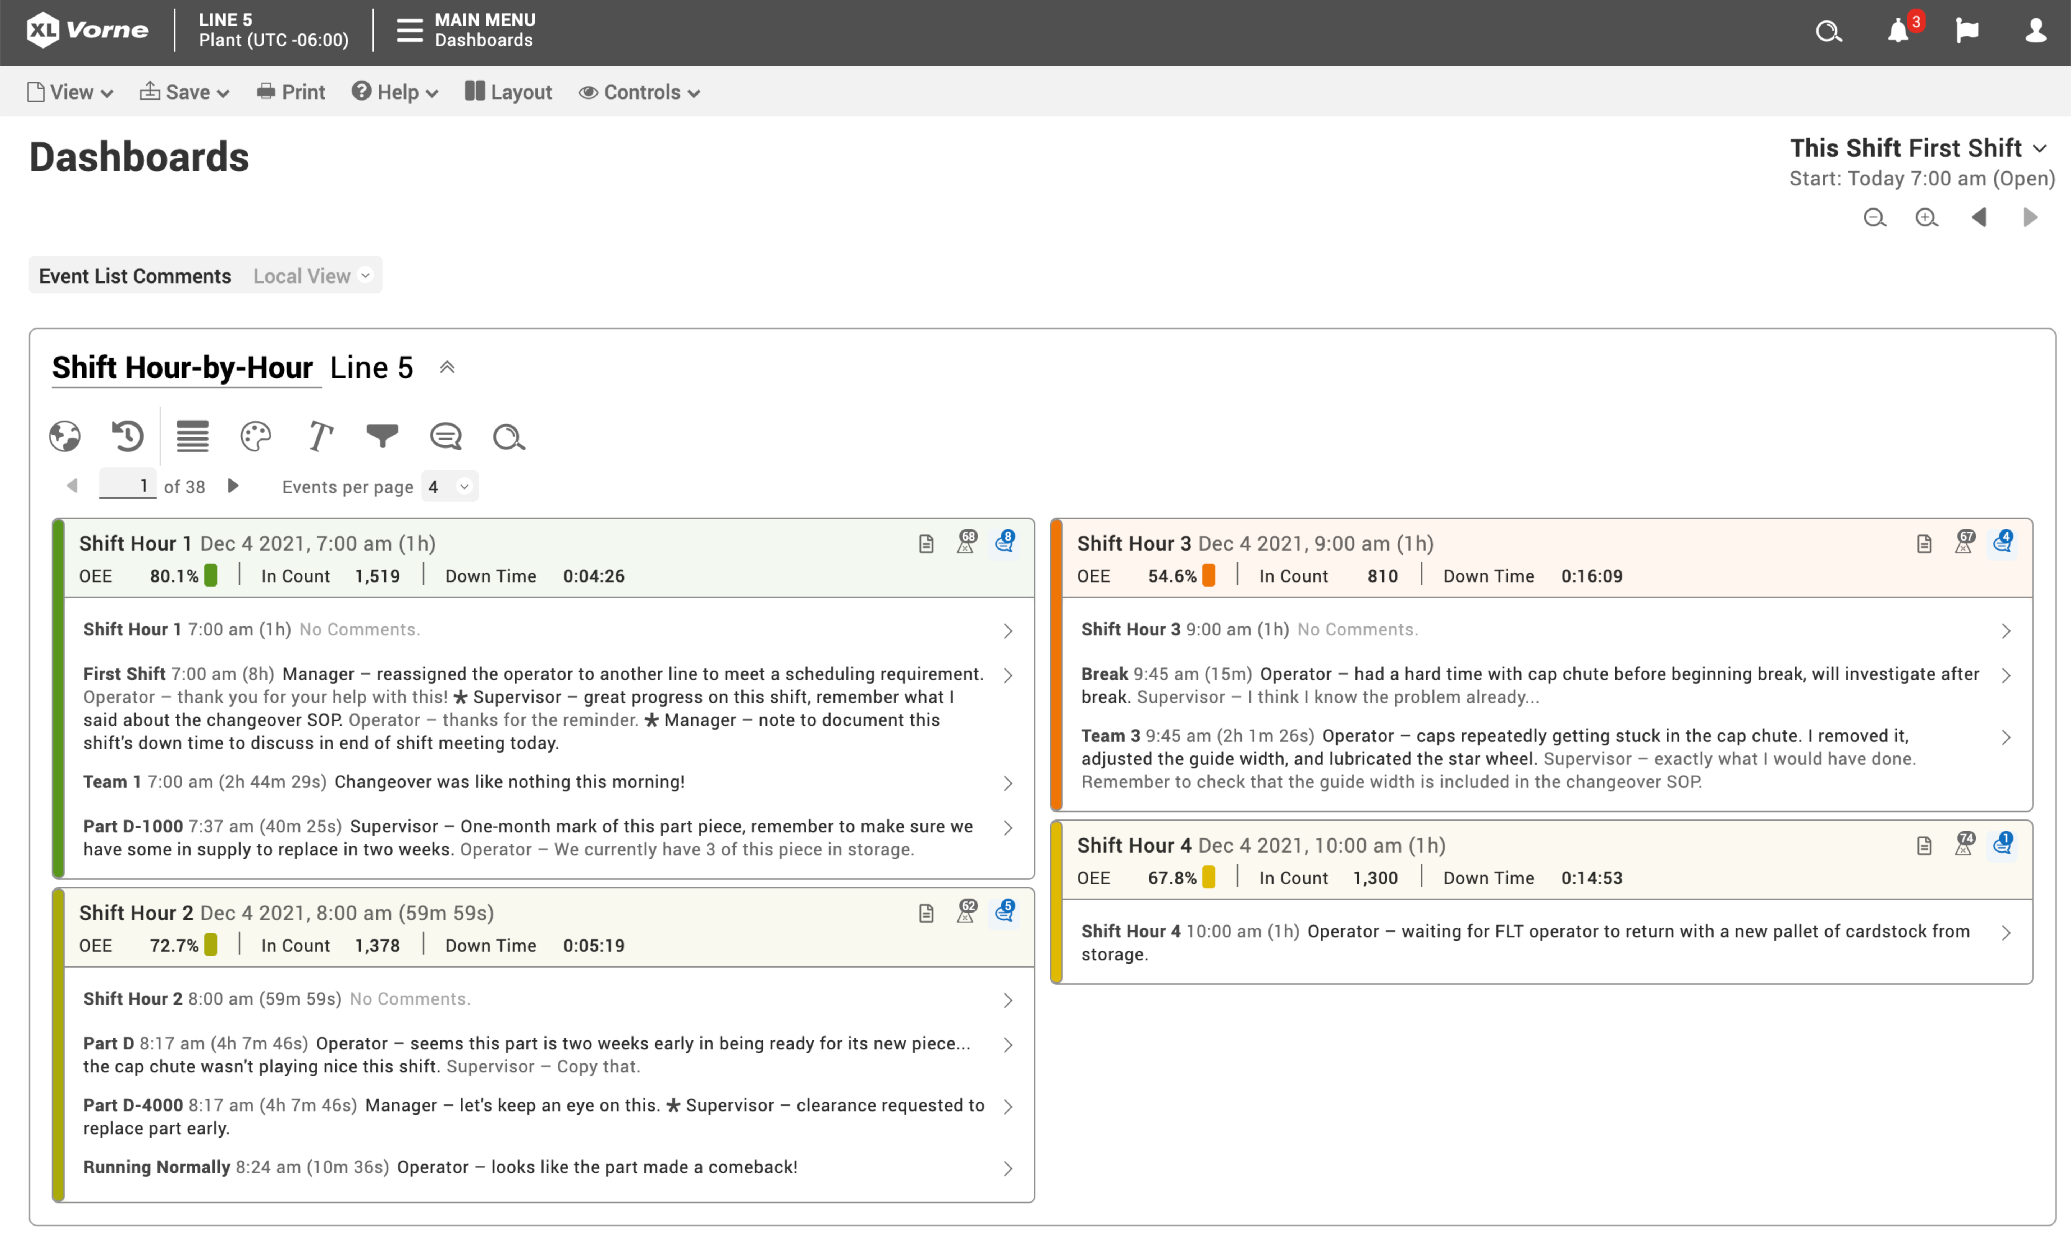
Add Context with Comments
Add freeform comments to any event.
Provide valuable context for major losses
Post comments and replies
Easily search across all comments
Create personalized views to validate policy-based audits, such as:
  Down > 30 Minutes
  Part OEE < 65%
Introducing XL Powerful
27
www.vorne.com • 1.630.875.3600 • © 2021-2024 Vorne

Slide 28
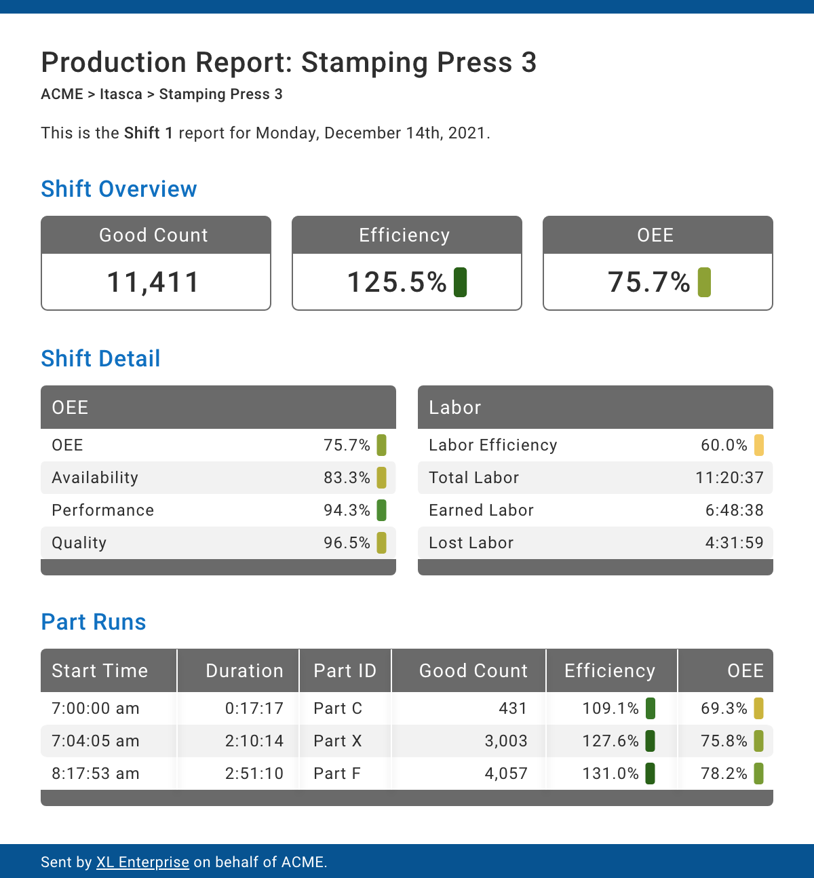
Email Alerts
and Reports
Proactive management through push notifications.
Instant notification when your attention is needed
Automatically escalate alerts to supervisors and managers
Receive reports directly in your inbox at the end of each shift, day, week, or month
Focus reports on work centers, areas, sites, or your entire enterprise
Introducing XL Powerful
28
www.vorne.com • 1.630.875.3600 • © 2021-2024 Vorne

Slide 29
What is XL?
Slide 2
Easy
Slide 8
Powerful
Slide 12
Cost-Effective
Succeed with Vorne
Slide 34
Introducing XL Cost-Effective
29
www.vorne.com • 1.630.875.3600 • © 2021-2024 Vorne

Slide 30
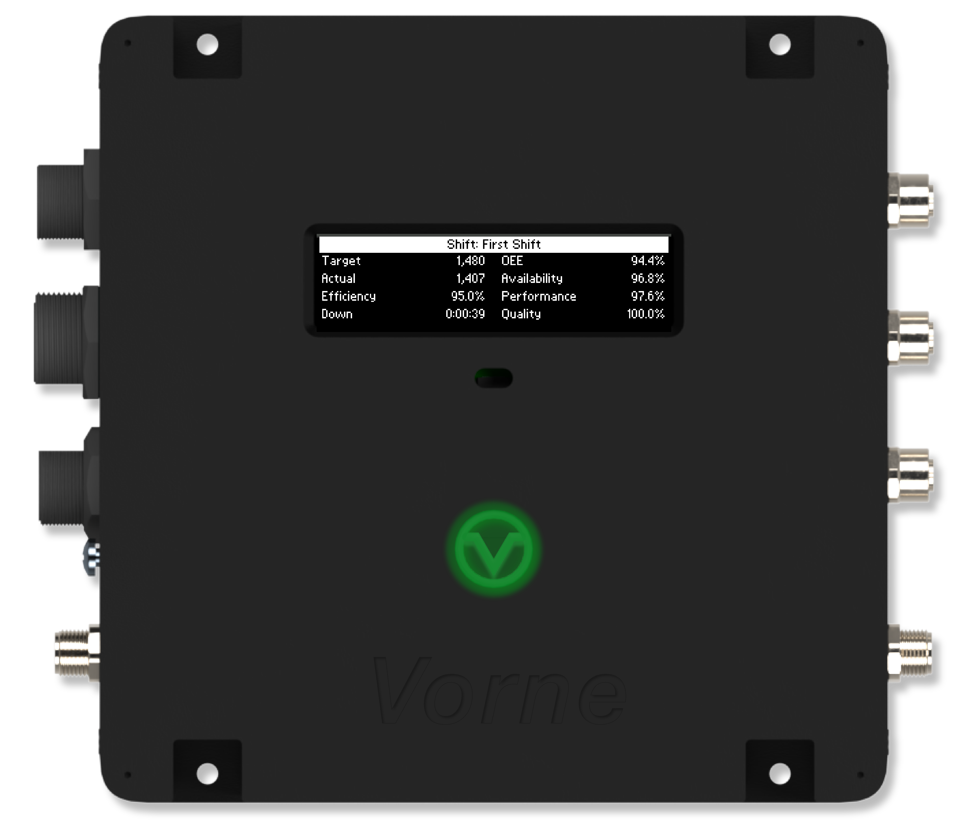
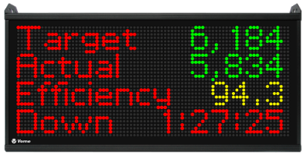
Transparent Pricing
Easy to use. Easy to buy.
Four models - all with identical features and reporting capabilities
Select the scoreboard model that best fits your needs
No recurring license, maintenance, or support fees
Expansion and volume discounts
Model | Price
XL HD | $3,990†
XL 810-1 | $4,190†
XL 610 | $3,590†
XL 810-2 | $4,990†
XL HD $3,990†
XL810-1 $4,190†
† US Domestic Prices
Introducing XL Cost-Effective
30
www.vorne.com • 1.630.875.3600 • © 2021-2024 Vorne

Slide 31
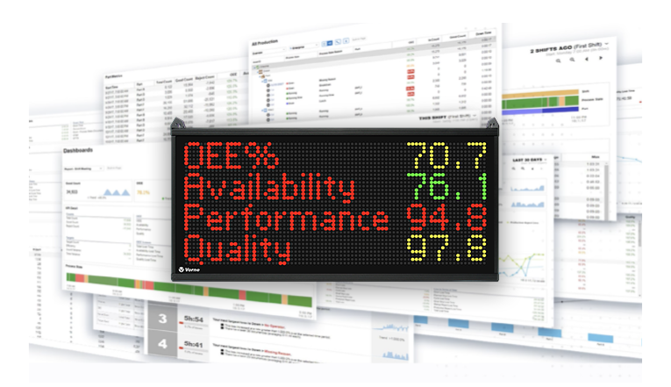
Unbeatable Value
A standardized off-the-shelf product that easily adapts to you.
All features included for one low cost
Match XL to your process with point-and-click configuration
Built on manufacturing best practices and our experience from 35,000+ installs
Turnkey solutions available for easy integration
Introducing XL Cost-Effective
31
www.vorne.com • 1.630.875.3600 • © 2021-2024 Vorne

Slide 32
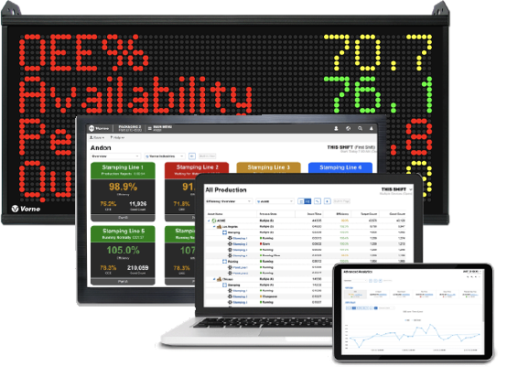
A Platform for You
A great investment that grows with you.
Free software updates
Frequent feature releases
Visit www.vorne.com/new to see what’s new
Free technical support
3-year warranty
Deep ecosystem of international, developer, and consulting partners
Improvement best practices are integrated into the platform
Introducing XL Cost-Effective
32
www.vorne.com • 1.630.875.3600 • © 2021-2024 Vorne

Slide 33
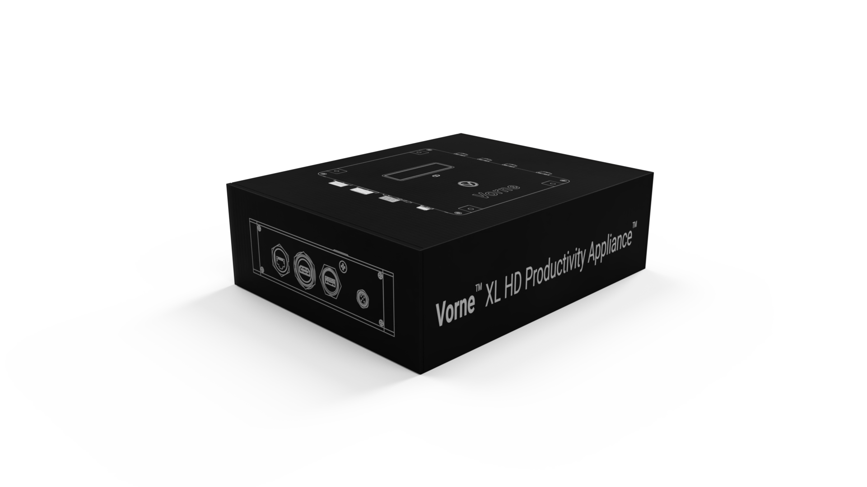
Free 90-Day Trial
See the future now.
Start with a webinar where we focus on your application and your questions
We’ll send you a trial unit of your choice
Trials have full support from Vorne – test our support as well as our product
Streamlined process – we’ve successfully completed 2,500+ trials
92.1% of customers that try XL, buy XL
Introducing XL Cost-Effective
33
www.vorne.com • 1.630.875.3600 • © 2021-2024 Vorne

Slide 34
What is XL?
Slide 2
Easy
Slide 8
Powerful
Slide 12
Cost-Effective
Slide 29
Succeed with Vorne
Introducing XL Succeed with Vorne
34
www.vorne.com • 1.630.875.3600 • © 2021-2024 Vorne

Slide 35
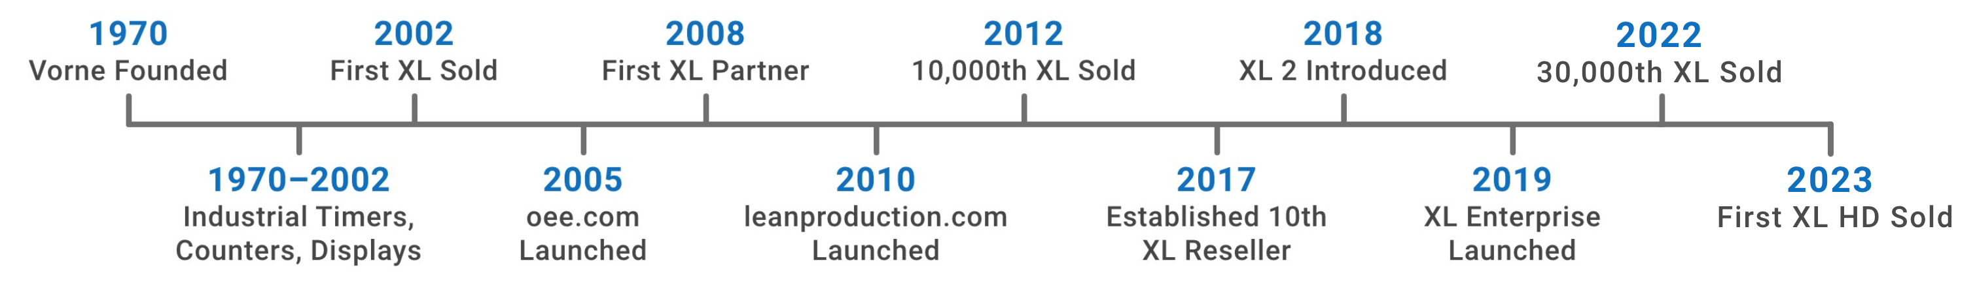
Vorne An Exceptional Partner
Improving manufacturing since 1970.
Over 50 years of experience manufacturing industrial electronics
Market leader in production monitoring solutions and analytics
35,000+ installations in 45+ countries
Introducing XL Succeed with Vorne
35
www.vorne.com • 1.630.875.3600 • © 2021-2024 Vorne

Slide 36
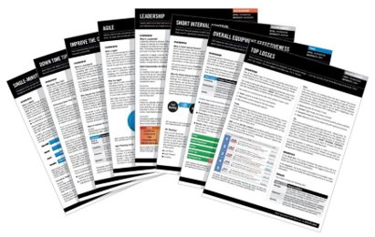
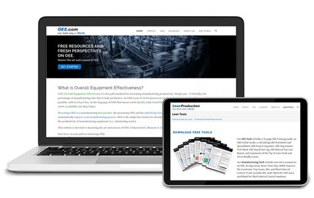
Manufacturing
Improvement Experts
Recognized leaders in our industry. Vorne…
Publishes oee.com and leanproduction.com
Presents at industry and corporate conferences
Educates with improvement topics and techniques
Innovates with patented technologies
Introducing XL Succeed with Vorne
36
www.vorne.com • 1.630.875.3600 • © 2021-2024 Vorne

Slide 37
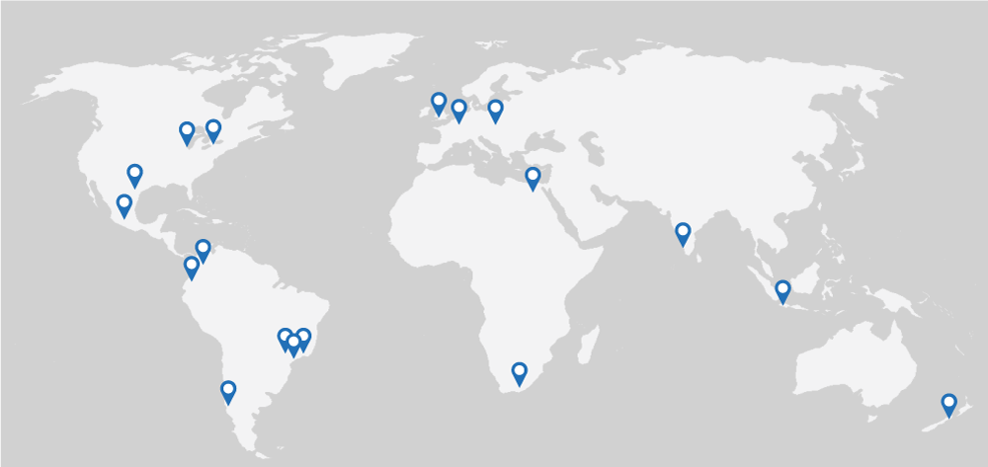
Global Reach
20 international partners. 45+ countries.
ACI Belgium
BIMSO Colombia
C9 Business Solutions Dominican Republic
Gestion Operacional Chile
IFD Representatives Ecuador
IIOTExpert India
Lean Solución Mexico
Lean Expert Puerto Rico
Line Andon Egypt
LineView Solutions UK
Prodasis Mexico
RSquare Konnect India
S4 Automation South Africa
Tanand Technology Malaysia
TQMsoft Poland
Trinity Business Solutions Brazil
Vetii | TECH USA
Vince Soluções e Tecnologia Brazil
Workflow Ltd New Zealand
ZIN Corporation South Africa
Introducing XL Succeed with Vorne
37
www.vorne.com • 1.630.875.3600 • © 2021-2024 Vorne

Slide 38
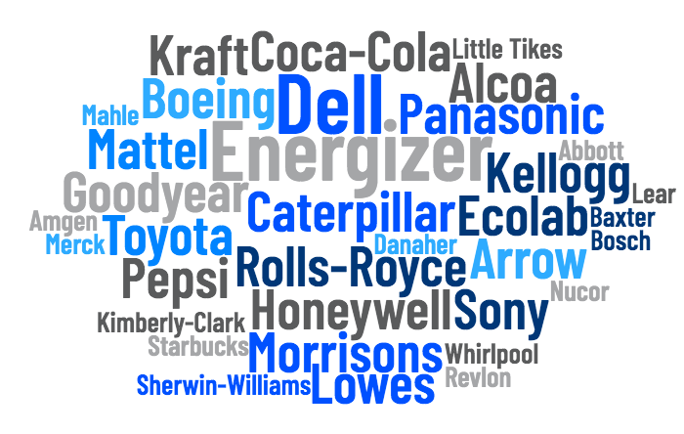
You’re In
Good Company
XL is trusted by thousands
of companies.
Driving improvement across the full spectrum of manufacturing
Applies easily to different processes and industries
Click here to see companies using XL within different industries.
Click here to see comments from our customers
Introducing XL Succeed with Vorne
38
www.vorne.com • 1.630.875.3600 • © 2021-2024 Vorne

Slide 39
Why Choose XL?
XL is your fastest path to improving manufacturing productivity.
XL is Easy
XL is Powerful
XL is Cost-Effective
Installs in hours
Incredibly easy to use
No additional staff needed
Free technical support
Free software updates
Proven global platform
Complete visibility of manufacturing lines
Integrated scoreboard & reports
100+ metrics & dimensions
Rolls up data across plants
Configurable dashboards
Built-in, shared, personal views
One-time cost
No fees or licenses
No contracts
No limits on users
Expansion & volume discounts
90-day free trial
Introducing XL Succeed with Vorne
39
www.vorne.com • 1.630.875.3600 • © 2021-2024 Vorne

Slide 40

Thank you
Email
Call
Visit
sales@vorne.com
+1.630.875.3600
www.vorne.com
Introducing XL 2.18 Revised December 4, 2023
www.vorne.com • 1.630.875.3600 • © 2021-2024 Vorne Industries, Inc. • Itasca, IL

